Slide 1
FoCal Readout and Trigger
K. Oyama
Nagasaki Institute of Applied Science
2nd International Workshop on Forward Physics and Forward Calorimeter Upgrade in ALICE, Tsukuba, JAPAN, 13, Mar. 2023

Slide 2
FoCal PAD Readout Scheme (review)
Developments finished by Grenoble
5 HGCROCs on one board (5 x 72=360 pads)
1/22 of entire FoCal
Picture from draft paper “Prototype electronics for the silicon pad layers of the future Forward Calorimeter (FoCal) of the ALICE experiment at the LHC”, O. Bourrion et al.

Slide 3
FoCal PAD Readout Scheme (review)
An aggregator FPGA processes data from four 5-pad boards (20 HGCROCS)
zero suppression & formatting
trigger sum
control
FPGA
GBT
GBT
aggregator
20 HGCROC connected to a FPGA
40 eLinks for Data
40 eLinks for Trigger Sum
HGCROC data b.w. (1.28 Gbps x 40=51.2 Gbps) is compressed and sent by 2 GBT links (3.2 Gbps x 2) by:
trigger (up to 200-500 kHz) → 32bit x 72ch x 20 HGCROCs x 500 kHz = 23 Gbps
zero suppression (1-12%, avg. < 10%) → 2.3 Gbps … ok for up to ~25% avg. occupancy
Picture from draft paper “Prototype electronics for the silicon pad layers of the future Forward Calorimeter (FoCal) of the ALICE experiment at the LHC”, O. Bourrion et al.

Slide 4
Pad Readout Scheme (questions)
Concerns during prototype developments
FPGA in radiation area
If not, then there are several solutions
replacing aggregator FPGA with ASIC (either existing ASIC or develop ourselves)
choose rad-hard FPGA and implement simpler logic
put the aggregator away (~5m) from the detector and pull copper cables
Can we readout for higher occupancy than 10% (such as pA) at 500 kHz? Similarly, can we readout pp at min.bias (1 MHz) for pad?
Switch to lpGBT (10.24 Gbps) gives 3 times higher b.w.
HGCROC data at 1 MHz pp → 32bit x 72ch x 20 HGCROCs x 1 MHz x 10%= 4.6 Gbps … OK!
With one lpGBT max. tolerated avg. occupancy is 10.24/46 = 22%
We don’t need to stick on grouping of 4 layers → (example) one lpGBT per 3 layers → 30% is tolerated
There is no reason not to use lpGBT anywas because it’s a next standard to GBT at CERN experiments
https://japan.xilinx.com/products/silicon-devices/fpga/rt-kintex-ultrascale.html#radiation

Slide 5
PAD readout concerns (summary)
Aggregator2
Present development by Grenoble + switch to lpGBT
radiation concern
rad-hard FPGA(minimum function) + SCA → ok
put aggregator away
Signal integrity problem with long 3960 copper cables for 1.28 Gbps to be solved
Introduce ASIC for data reduction and trigger sum
CMS ECON-D and ECON-T ASICs are candidates?
Original ASIC → long development time?
Not very high advantage in case of ECON-D compare to (d) in terms of number of lpGBTs
With our own ASICs, it can be similar to (a)
No FPGA nor ASIC for aggregation but use only lpGBT
Many optical fibers and many CRUs
Additional FPGA for (c) and (d) can be considered to reduce number of CRUs but may not give advantage in terms of cost
(a)
Rad-hard
FPGA
Lp GBT
CRU
<50 cm
3960 eLINK traces
5 CRU
~100 m 88 (=22x4) lpGBT fibers
(or 132 (=22x5))
Aggregator1+
(b)
FPGA
Lp GBT
CRU
>5 m
3960 eLINK long cables
(needs buffer in between?)
5 CRU
~100 m
88 lpGBT fibers
(c)
ASIC
Lp GBT
FPGA?
CRU
<50 cm
3960 eLINK traces
17 CRU
<396 lpGBT fibers
~100 m
numbers can be smaller depending on ASIC design
this is what TPC took, with GBT-SCA for slow control
(d)
Lp GBT
FPGA?
CRU
<50 cm
3960 eLINK traces
28 CRU
~100 m
min. 660 lpGBT fibers

Slide 6
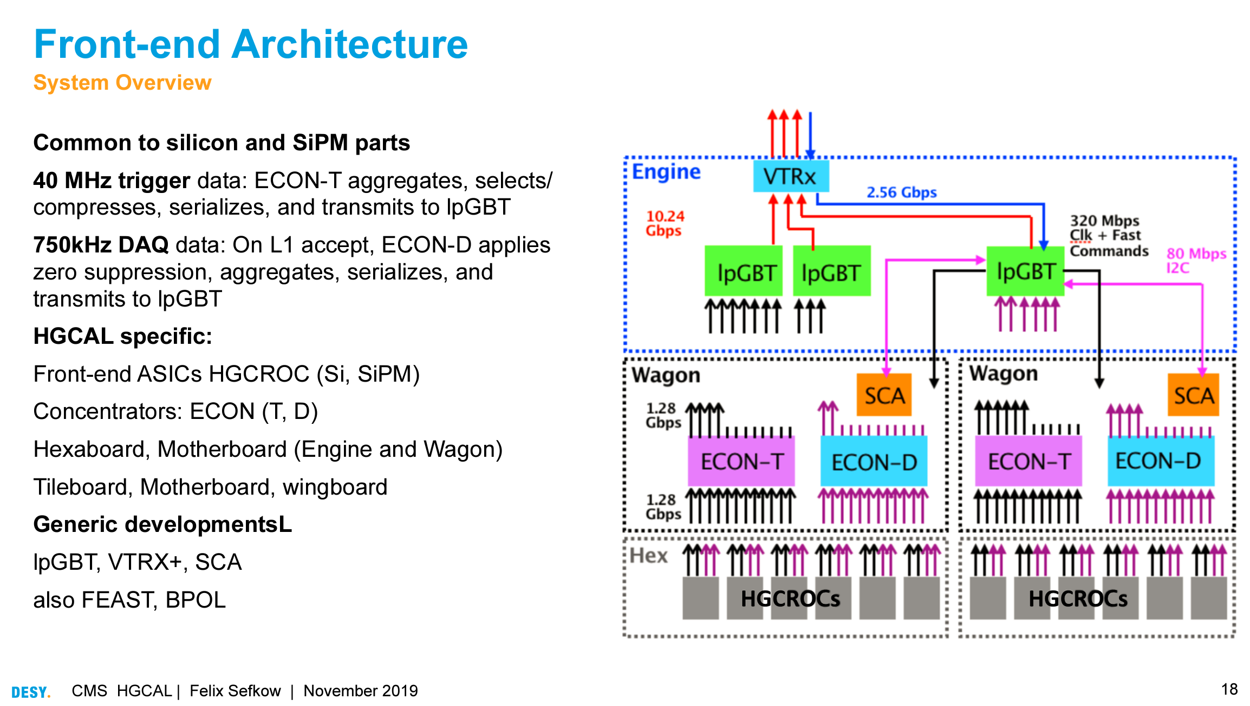
Using ECON-D and ECON-T ASICs?
https://indico.cern.ch/event/818783/contributions/3598486/attachments/1950405/3237629/HGCAL-CHEF19-FS.pdf

Slide 7
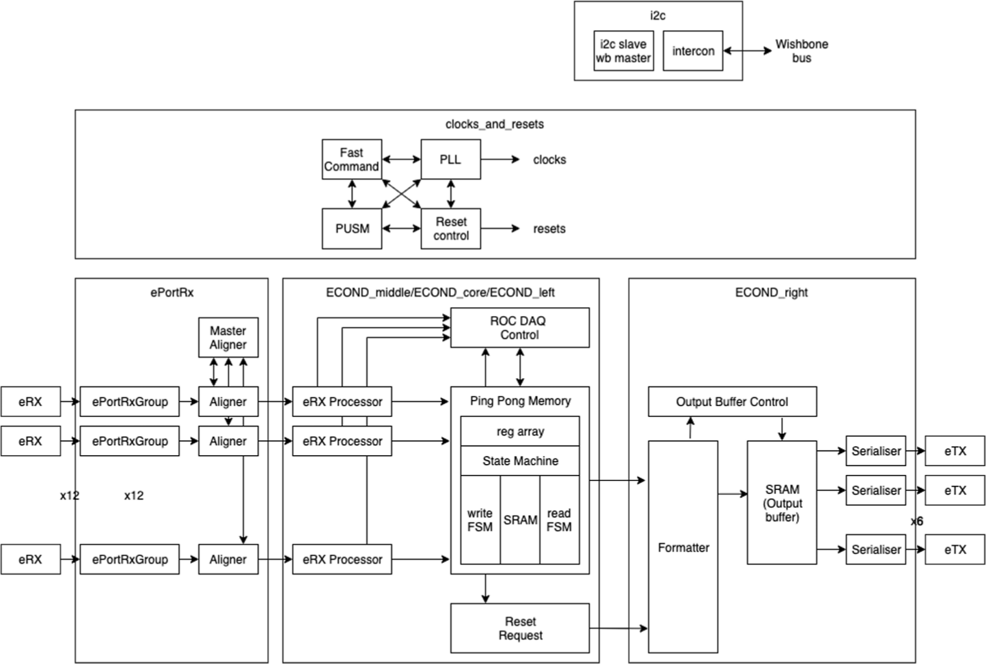
ECON-D
Basic use case by CMS: 12 eRX → 6 eTX → 1 LpGBT
However, it is also possible to enable/disable individual eTX according to data amount
Using two eTX is is safe (keep one as option)
eLink reduction factor is 12→2(6) or 10→2(5) depending on our layout
Necessary number of lpGBT is either 3960/5/6=132 (6 CRU) or 3960/6/6=110 (5 CRU)
Data reduction by
zero suppression (auto-corrected threshold)
All configuration through by GBT SCA
use only one or two For FoCAl

Slide 8
Possible readout scheme with ECON-D
To use full channels, 12 channels (6 HGCROC) is into one ECON-D is the best
since we have 18 layers, 3 layers x 6 groups is the best
but routing in Z direction is maybe not trivial
Maybe the most natural is one layer for one ECON-D
Aggregator2
unrealistic
ECON-D
ECON-D
SCA
lpGBT
fiber to CRU
ECON-D
short
distance
6 lpGBT per module
6x22=132 lpGBT for FoCal
short distance
through Grenoble style Interface Bard
3 full layers read out by a single lpGBT … maybe this is the best with enough safety margin
other option is to read out 6 layers by a lpGBT if it is really safe in terms of occupancy

Slide 9
Trigger
HGCROC maximum trigger rate: 1 MHz (sustained average)
It has long enough buffer → latency of CTP trigger is no problem
ALPIDE (Pixel) trigger rate is limited
It has only three event buffers inside, and no busy output (busy protection impossible)
Avoid busy violation by limiting individual readout rate of each strip
Busy violation flag is available → RU may detects and put in data stream
Assumption is that we limit readout rate to ~100 kHz (system-C simulation by Max will give us more precise and safe number) … see Dieter’s presentation
Timing of trigger to ALPIDE is crucial (CTP LM)

Slide 10
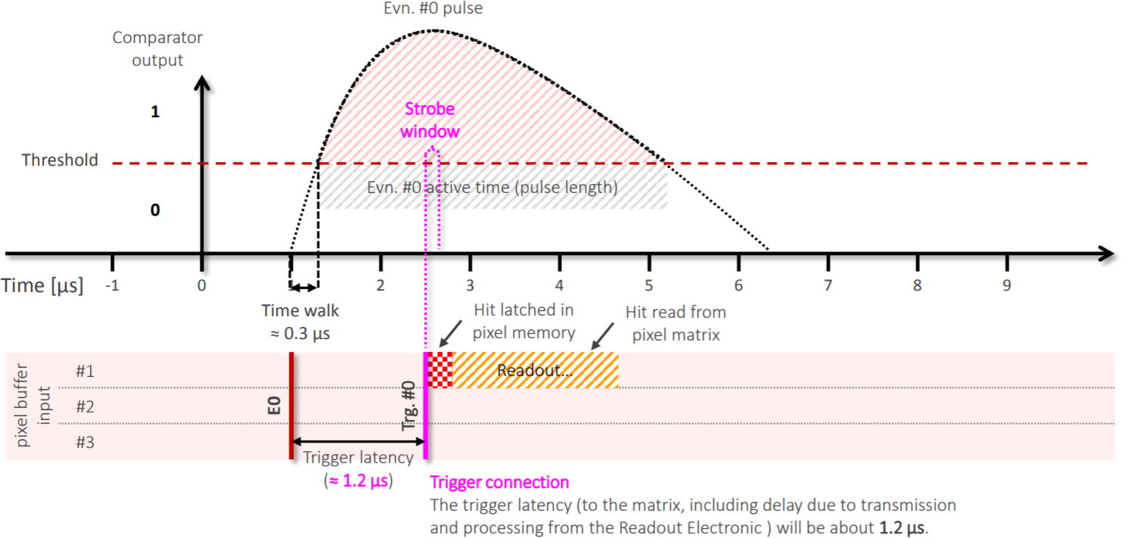
ALPIDE requirements for triggered mode
ITS2 requires LM (Level minus one, designed for TRD) arrival at ~1.2 μs
distribution via CRU doesn't fulfill the timing requirement (2.3 μs)
ITS2 took solution to directly send CTP LM to sensor through the RU
for details please see below (thanks Johan for providing this)
https://indico.cern.ch/event/580057/contributions/2382306/attachments/1390715/2135376/WP10_EDR_Timing_v6.pdf
https://indico.cern.ch/event/580057/contributions/2382324/attachments/1394559/2131547/WP10_EDR_trigger_distribution_v3.pdf
in FoCal case, we need to carefully think about how to trigger PIXEL by which trigger detector
only FIT will contribute to LM … only hadronic
UPC physics needs ZDC as trigger input but ZDC can’t do LM
FoCal self trigger is only solution?
what’s other physics?

Slide 11
ALPIDE pile-up
Event interval at 1 MHz min. bias operation can be below 1 μs (40 BC)
Events from other interaction overlap in given ALPIDE data
HGCROC
ALPIDE
c
c
1.2 μs
trigger
R
R
pad
For the second event, first and second events overlay, and we have no way to distinguish
→ we can flag or reject
We can associate and remove green signals from red events
(better we know green is there in offline)

Slide 12
Past-future protection at pad level
At trigger level, we can reject events with large overlap of physics signals in the same pad
HGCROC
ALPIDE
c
c
Clean event without any problem
Event highly contaminated with past and future events
At trigger level we can reject those events or put a flag (raw data stream)
CTP “may” reject events. So, we need to handle this at trigger processor

Slide 13
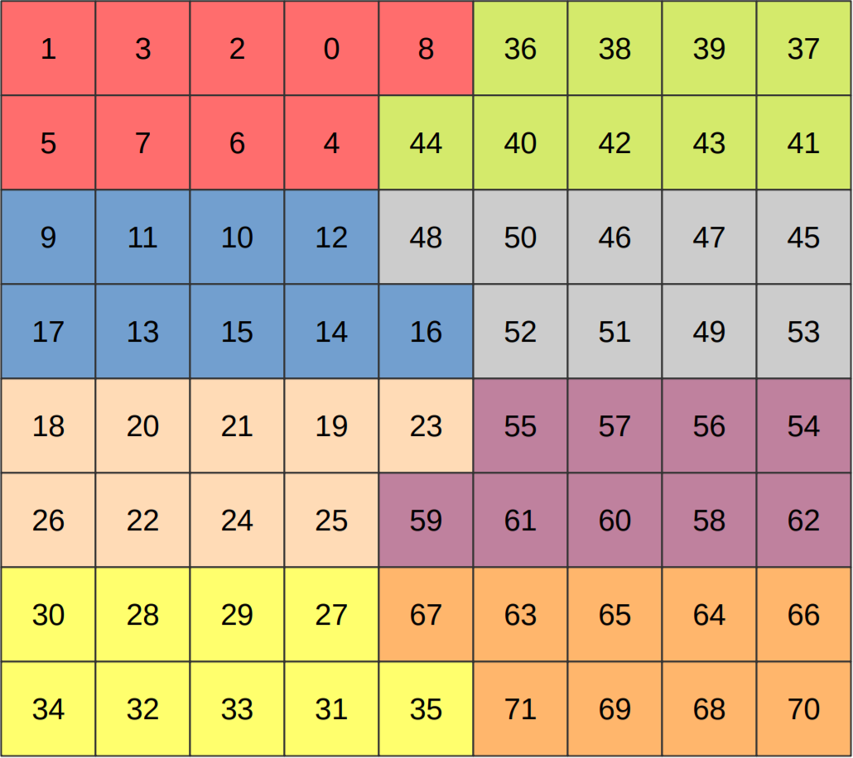
ALPIDE triggering idea
GLOBAL trigger for all PAD, HCAL and PIXEL
PAD and HCAL are fully read out with this (up to 1 MHz depending on Aggregator design)
ROI (region of interest) mask additionally for PIXEL
only strips with condition (GLOBAL && ROI) == 1 are read out (max rate: < 100 kHz)
global trigger using Pad and Hcal
for physics selection
(layers to use can be selected with wiring and FPGA programming)
ROI
at very low threshold
only pixel strips with signal in HGCROC at front and back (or few more if needed) are readout
necessary granularity has to be studied

Slide 14
Trigger very basic concept
FPGA based trigger processor for analyzing HGCROC trigger stream
GLOBAL: to CTP as L0 contribution input (min.bias, π⁰, γ, jet, UPC, …)
pretrigger: GLOBAL && ROI mask information only for PIXEL
Datastream for trigger and past-future information
GLOBAL
L0 contrib.
LVDS Coax.
Pad (&HCal)
(HGCROCs
and SCA)
HGCROC trigger stream
(selected lines)
4 pad layers → 880 eLinks
or already aggregated data
FoCal Trigger Processor
(large FPGA or 2 stages FPGAs)
CTP
to other ALICE detectors
→ HGCROC r/o trig. <1 MHz @ >1.6 μs + CTRL
→ data stream
← trigger + CTRL
→ data
pretrigger = GLOBAL && ROI
LTU
individual strip r/o trig.
rate < 100 kHz @ 1.2 μs
RU
PIXEL
CRUs
← CTRL
→ data
to DAQ
← trigger + CTRL
→ data

Slide 15
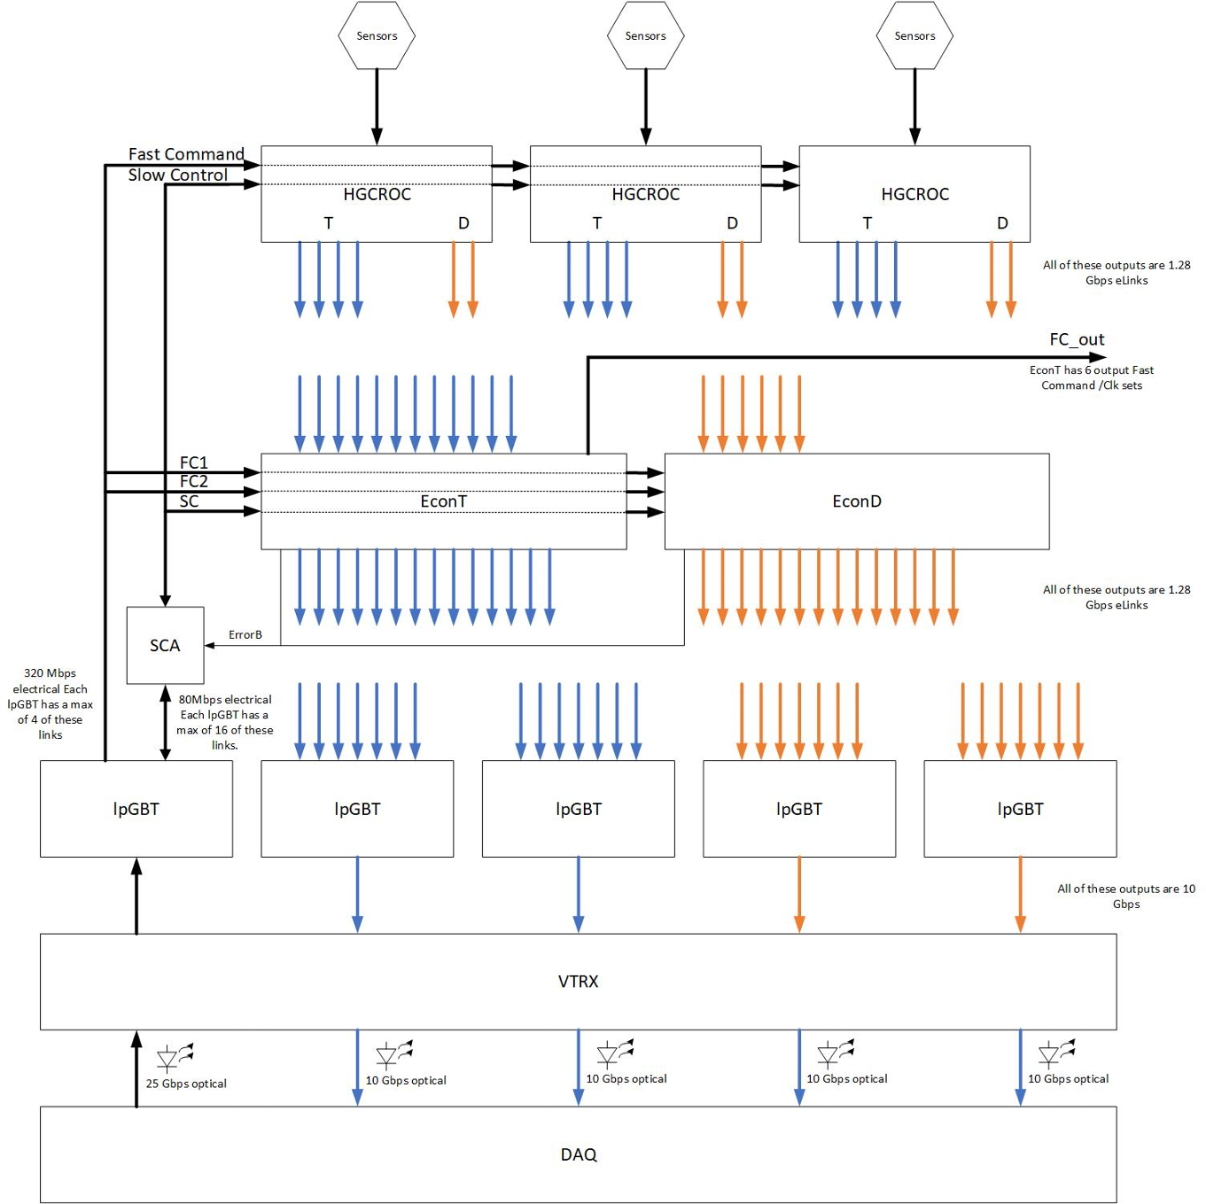
ECON-T
CMS trigger requirement: L1 at 750 kHz, 12.5 μs latency
ALICE (ALPIDE) trigger requirement: pre-trigger at 1.2 μs latency
ECON-T super trigger cell algorithm latency is 300 ns … good!
Port use is selectable, depending on algorithm to use
We need measurement and simulation
Note:
HGCROC fast control is directly from lpGBT and slow control of everything is using SCA
no extra clock recovery (PLL)
ALICE TPC (with SAMPA) also has the same concept (and working well)

Slide 16
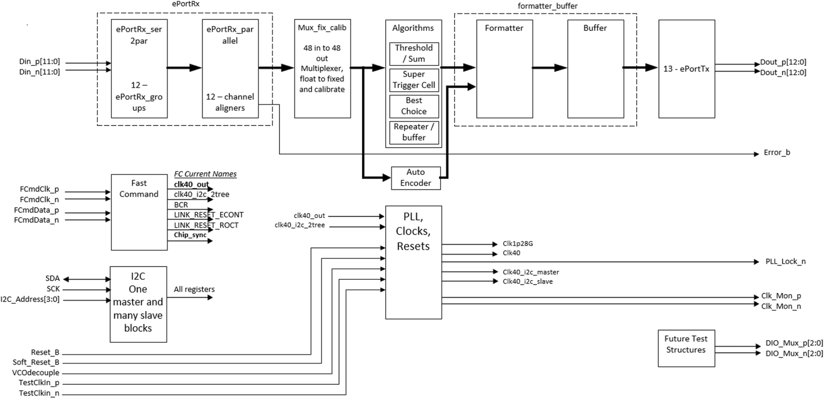
ECON-T
Super trigger cell (STC) algorithm is similar to what we are thinking for FoCal

Slide 17
ECON-T
STC16 (16 TC into one sum): 16x7 bits → 4E+3M+4A(11 bits)
reduction factor of 11/112 ~ 0.1
might be possible 12 eRX into 2 eTX (careful check needed)
assuming so:
we can reduce 3960 HGCROC trigger outputs eLinks to 660 eLinks
Since latency is low, maybe we can collect them using lpGBT
660/6 = 110 lpGBT
We may not connect “entire” pad layers assuming only 4 layers (4/18), 110 can be reduced to 25 lpGBTs
feasible to inject into one FPGA for trigger processor
but we loose charge collection statistics and energy resolution if we want to trigger for shower or jet
for min.bias trigger, it might be ok

Slide 18
Layout consideration with ECON-T
HGCROC
STC16 (16 trigger cell into one sum)
1 HGCROC has 8 trigger cells → SRC16 perform two HGCROC into one sum
two HGCROCs in the same tower is better for also to keep position granularity in trigger algorithm (pattern b instead of a)
a group has 2 layers instead of 3 layers for ECON-D
Need to check with pixel
IB configuration 3 ALPIDEs corresponding to 1 HGCROC geometry can be triggered individually
pad
****
trigger
cell (STC)
trigger cell
(a)
?
(b)
to the same ECON-T

Slide 19
Aggregator ver.2 with FPGA?
Replace ETH for controlling and monitoring with GBT SCA
Replace GBT with lpGBT
Limit function of FPGA for to reduce radiation cross section
Add function to recover FPGA configuration during run

Slide 20
Possible layout of Aggregator 2
for data reduction in FPGA, Grenoble development can be ported
less function → smaller PCB
lpGBT optical through firefly?
x6 for a module
x6 x22 for whole FoCal
Aggregator 2
FPGA
(R.T. or Normal)
or
ASIC
6 eLinks
lpGBT
data
data
(30 eLinks)
(fiber)
6 eLinks
lpGBT
trigsum
trigger sum
(30 eLinks)
(fiber)
lpGBT
trig&CTRL
(re-)configuration
(fiber)
FPGA
(R.H.)
VReg.
GBT
SCA
trigger/clock/fast control
slow control I2C

Slide 21
To do as summary and comparison
Trigger processor
design fully deepens on readout solution of pad
looking for “many” input FPGA board
test implementation of logic
simulation of trigger performance
Aggregator ver.2 design … we may go with keeping different solutions
ECONs
obtain and evaluate ECON-T first then ECON-D, probably with Saga setup?
300 ECON-T packaged available … some can be given to ALICE
ECON-T more production in a year and ECON-D production submission done
(for final production, cost for wafer: $4600 for 200 chips → $2.4 /chip (+ packaging))
detail discussion with CMS people and technical information transfer needed
can’t expect full support for board design, debugging, operation
(rad-hard) FPGA
investigation of rad-hard type or testing normal FPGA in radiation?
other than that, the easiest and quickest solution
own digital ASIC
VDEC framework of university of Tokyo can be used
experienced people are there (Tsukuba, Saga, Nagasaki, and …)
problems is development time
not fully reconfigurable (except for parameters)
very good to have this experience for our future experiments
start prototyping by earning grant (its also investments for future)
no-aggregation
cost? … we need anyways more FPGAs for trigger data collection and more CRU for data reception

Slide 22
backup

Slide 23
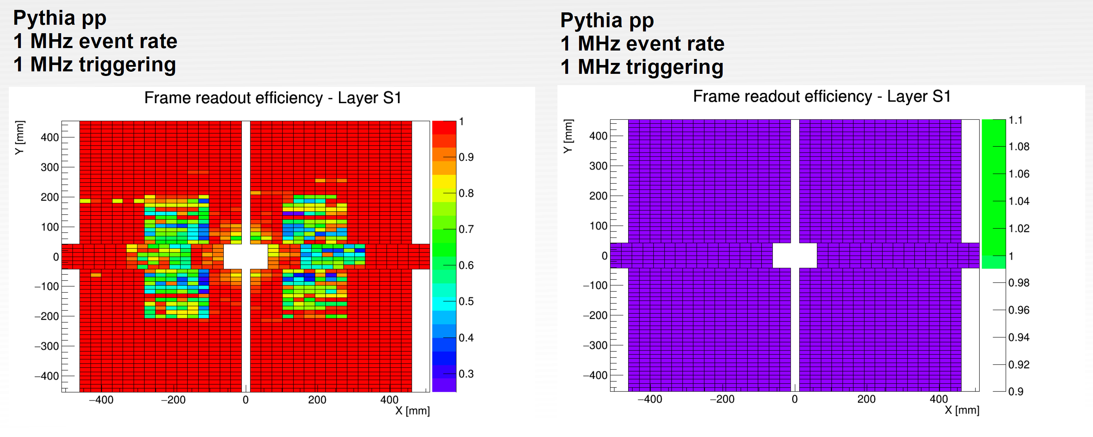
Busy violation
ALPIDE has three “buffer depth”, w/o busy protection, data size depends on occupancy
too high trigger rate will cause busy violation (buffer full but received trigger)
preliminary result from Max https://indico.cern.ch/event/1166784/

Slide 24
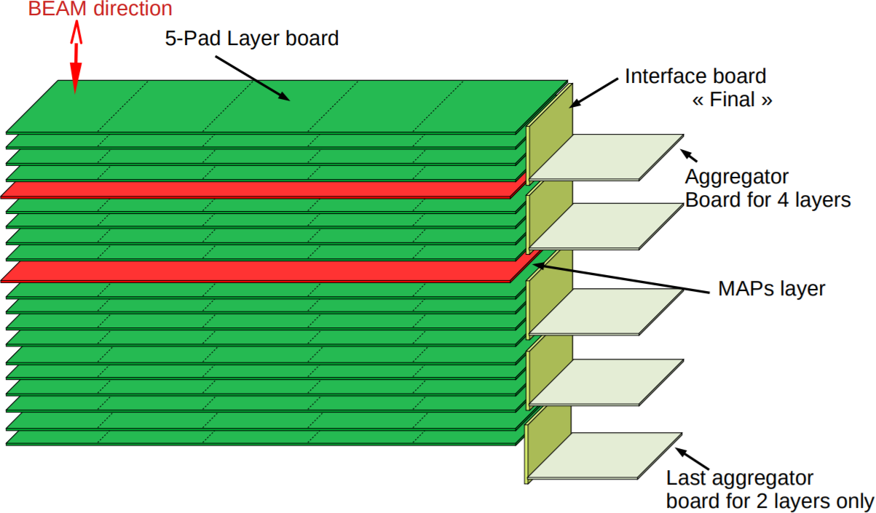
Detail trigger scheme (yet an idea)
micro TCA crate
trigger sum stream ~1280 bps x 180 links (wire, 5m)
data output stream
~1280 Gbps x 180 links (wire, 5m)
total max 4 x 10 = 40 Gbps
not far from micro TCA crate, or in the same crate
from other 3 or 4 of 5-pad modules
(1/6 of total FoCal Epad)
Local Trigger
Concentrator
25 Gbps non SERDES link
(mult. wires, ?m)
FTP
(FoCal Trigger Processor)
EPad (&HCal)
5 tower mod.
90 HGCROCs
Aggregator2
from
other 5 Epad
regions
40
trigger
40
40
from HCal
40
LM contrib.
decision (bidir.)
40
1-2 Gbps x 10 trigger sum
(wire <50cm)
no need to install all
40
pre-trigger is
optional in case LM via CTP is too late
AND we run PIXEL with triggered mode
CTP
40
40
20
trigger information to record
20
LTU
ALICE trigger
Decisions
and timing
x4 HGCROC into one sum
PIXEL
pre-trigger decision within 1200 ns
pre-trigger decision within ~1000 ns
CRUs
RU
pre-triggered data
trigger and data (GBT bidirectional)
FLP
advantage: full flexibility on choice of global trigger / ROI elements (matter of wiring and firmware)

Slide 25
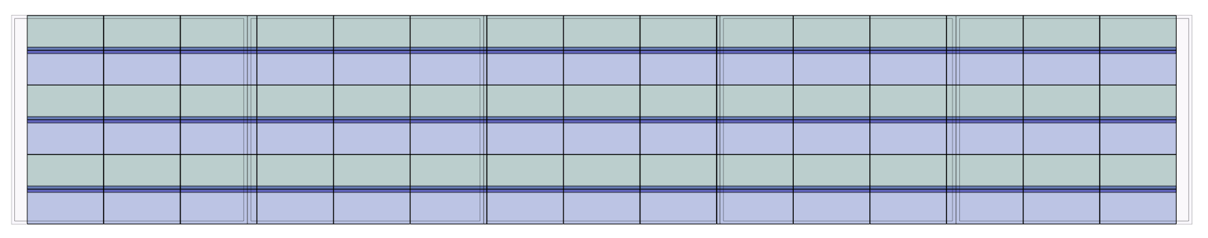
ALPIDE triggering idea
system-C simulation will soon tell us how often we can trigger ALPIDE safely
assuming ~100 kHz for pp is a safe limit
GLOBAL physics triggers aggregated rejection factor of 5-10 will be safe with ROI
assuming 3-5 different triggers, individual trigger may be required better than 10-20
additionally
limit readout region for ALPIDE using HGCROC trigger stream → ROI: region of interest
with enough low threshold on charge
AND arithmetic with GLOBAL trigger
minimum ROI region size depends on PIXEL strip readout configuration
picture provided by Tea

Slide 26
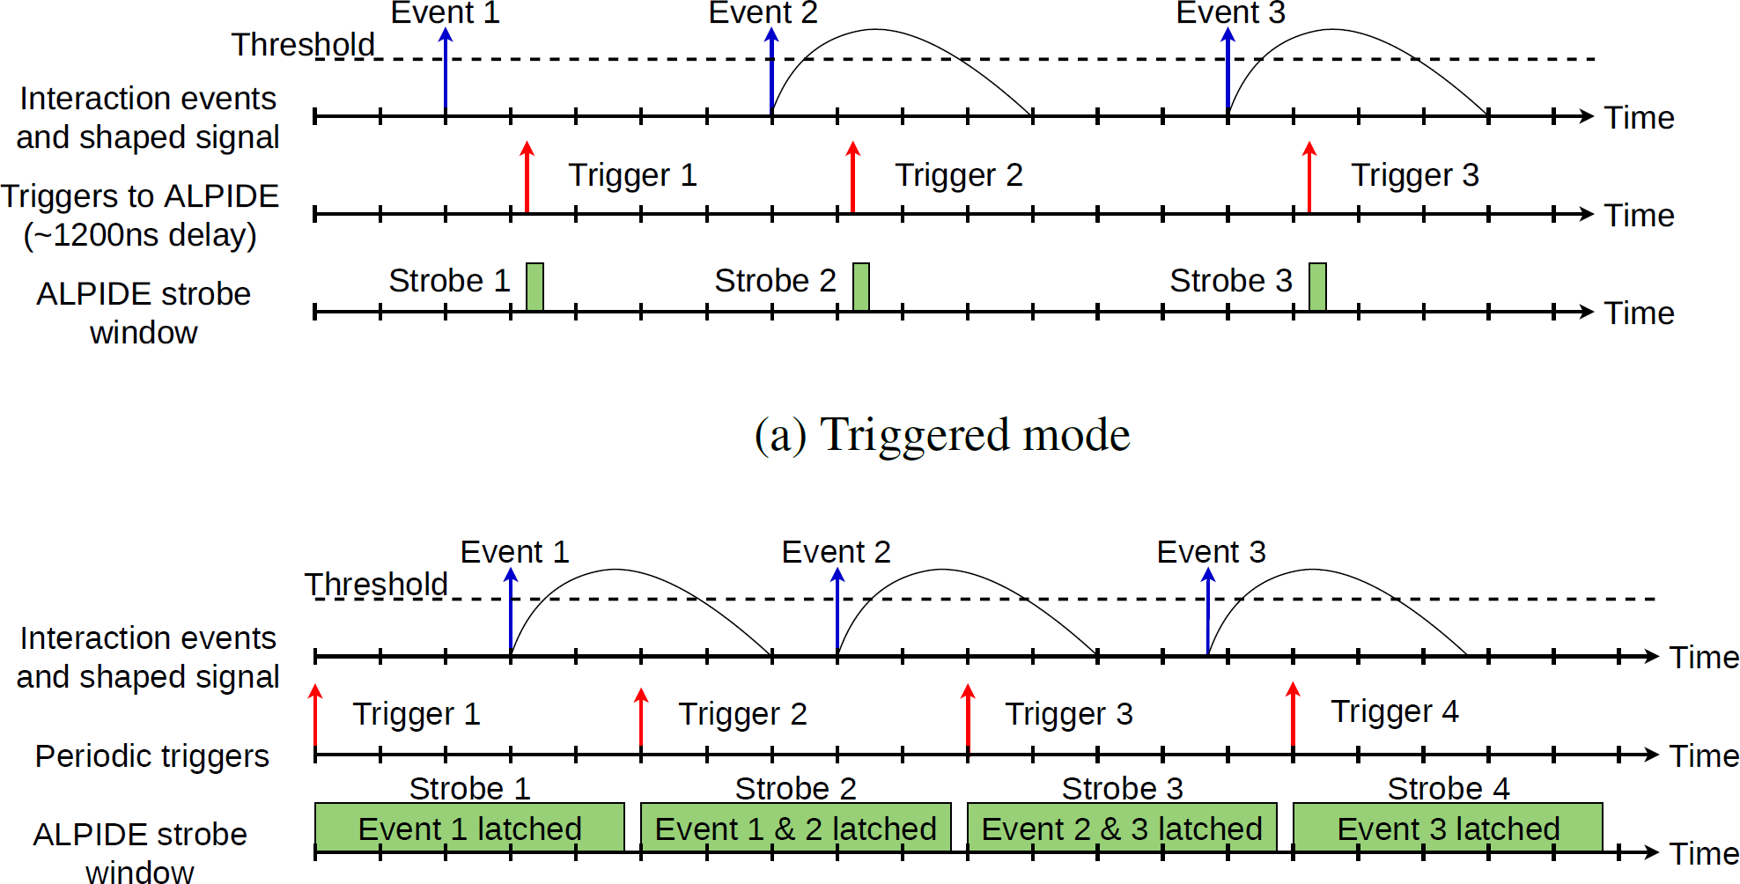
ALPIDE readout
supports triggered and continuous modes
continuous mode is equivalent to periodic trigger with long gate (ITS uses only this for physics)
fake hits, noise and background (beam-gas) … needs study
at FoCal, impossible to distinguish pile-up (minimum event interval can be much below 1 μs)
triggered
continuous
(baseline)
S. V. Nesbo et al., “System simulations for the ALICE ITS detector upgrade”, EPJ Web of Conferences 245, 02011 (2020) https://bora.uib.no/bora-xmlui/bitstream/handle/11250/2731420/epjconf_chep2020_02011.pdf

Slide 27
a
Aggregator
FPGA
GBT
compressed data to
CRU (FPGA farm)
Si pad layer with
5 HGCROCs
GBT
digested trigger data
to trigger processor (FPGA)
20 HGCROC
40 eLinks for Data
40 eLinks for Trigger
pad
****
trigger
cell (STC)
trigger cell
HGCROC

Slide 28
Review: our present aggregator
One HGCROC has two 1.28 Gbps eLinks for data output
4 of 5-pad layer is to be readout by the aggregator
20 HGCROC = 40 eLinks
concentrated to 1 GBT of 3.2 Gbps
wire reduction factor 1/40
using LpGBT (10Gbps), it can be better than 1/100
method: trigger, Z.S., and link speed
Similarly for trigger
Problem is radiation

