Slide 1
LHC-ALICEにおけるエキゾチック系探索の現状と今後の可能性
大山 健
長崎総合科学大学
Aug.8, 2019 第５回「物質階層を横断する会」～ハドロン・原子核・原子・分子合同ミーティング：軽いグザイハイパー核の構造と生成 @ RIKEN

Slide 2
ALICE@LHC upgrades for Run3
New Inner Tracking System (ITS)
MAPS: improved resolution, less material, faster readout
New Forward Muon Tracker (MFT)
vertex tracker at forward rapidity
New TPC Readout Chambers
4-GEM detectors
New trigger detectors (FIT, AD)
+ centrality, event plane determination
Upgraded read-out for TOF, TRD, MUON, ZDC, EMCal, PHOS, integrated Online-Offline system (O2)
record minimum-bias Pb-Pb data at 50 kHz

Slide 3
LHC long term plan
now
LS2 : 2019 – 2020
Experiments upgrade phase 1
Injector upgrade
Civil engineering for HL-LHC at ATLAS, CMS
Magnet and cryogenics
LS3 : 2024 – 2026
Experiments upgrade phase 2
HL-LHC preparation
Run3 : 2021 – 2023
x2 pp nominal luminosity
x6 PbPb nominal luminosity → 50 kHz
Run4 : 2026 – with HL-LHC
x5 to x7 nominal luminosity
x7 PbPb nominal luminosity
after
HE-LHC (27 TeV) and FCC at 100 TeV (~2040)
see more detail in Frederick Bordry’s talk in LHCP 2018

Slide 4
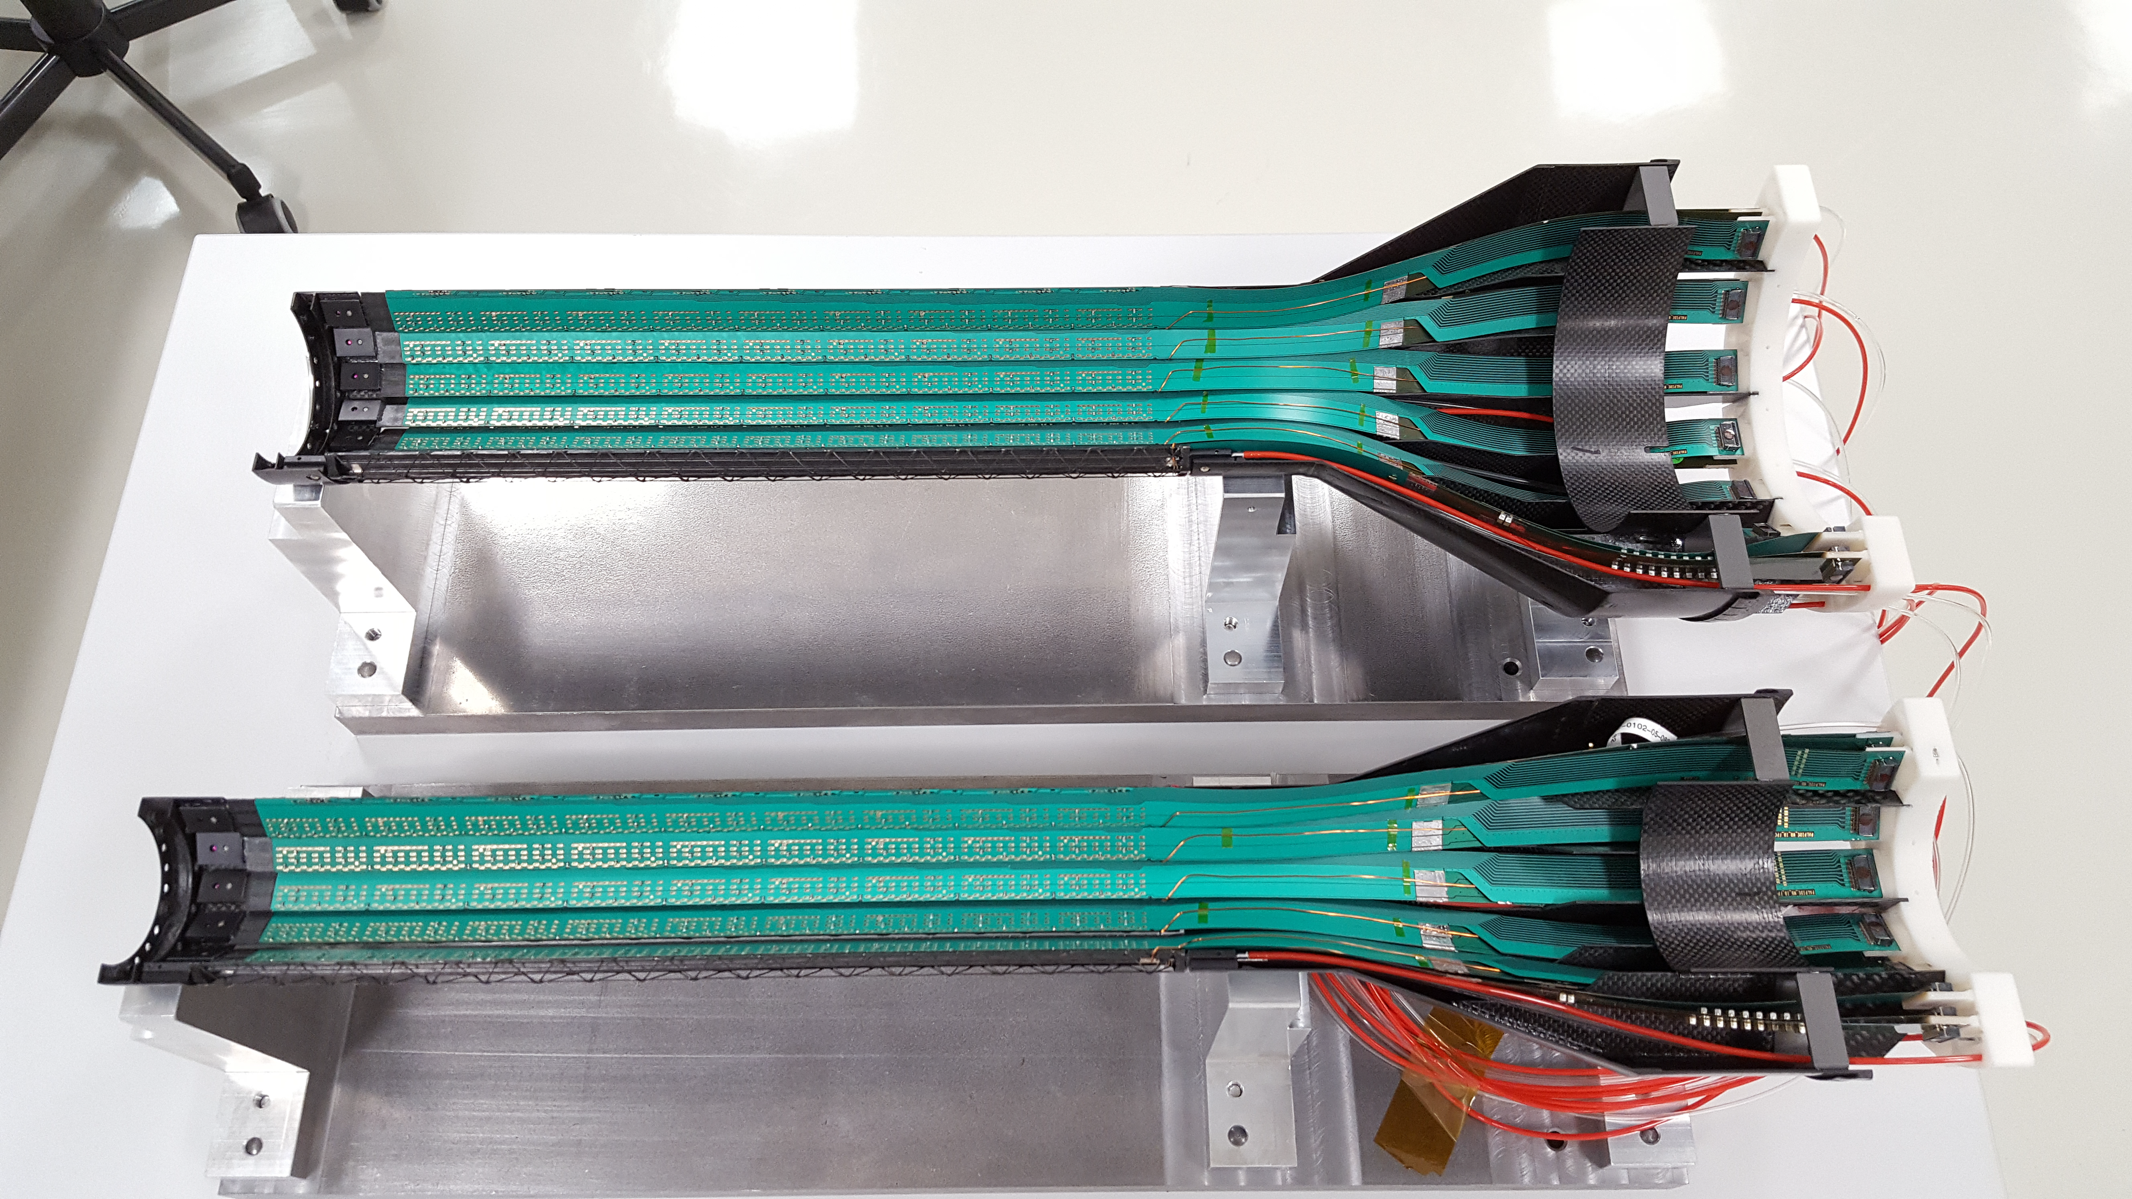
Inner Tracking System
Replaces old silicon detectors with new sensors
CMOS Monolithic Active Pixel Sensor (MAPS)
7 layers full pixel detector (before combination of strip, drift, and pixel)
Light weight with carbon structure
Larger area (10 m²)
More pseudo rapidity coverage (–1.22 < η < 1.22)
First layer closer to interaction point (39 mm → 22 mm)
New beam pipe
Low material (1.44% → 0.3% X₀)
Smaller pixel (50x425 → 27x28 μm²)
Faster readout (1 kHz(slowest) → 100 kHz))

Slide 5
MFT as a new detector
New detector in ALICE
Add vertexing capability in muon spectrometer system
Distinguish prompt J/ψ from B decay
5 layer silicon pixels (ITS technology)
0.4 m² area

Slide 6
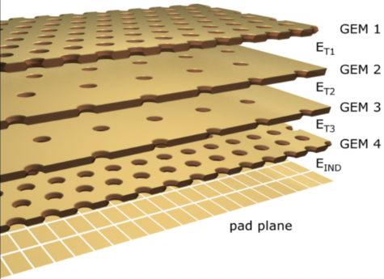
TPC Upgrade
The most important and challenging upgrade in ALICE
4 GEM system replaces traditional wire amplification system
decrease “dead-time” due to ion absorption time
500 ns down to zero → data rate from 2 kHz to ∞
530k channels, 200 ns sampling ADC data come out
3.5 TB/s continuous data rate
massive online computing power required
CNS-Tokyo, Nagasaki-IAS from Japan

Slide 7
TPC Upgrade (cont.)
data
data
LHC may provide above 50 kHz event rate after upgrade
Means 3.5 TB/s data rate
TPC drift time (100 μs)
20 × TPC drift time (= 2 ms)

Slide 8
Data taking upgrade without hardware trigger
What’s hardware trigger?
find interesting event such as high momentum particle, jet, etc
initiate detector data readout
readout time (TPC case: 500 μs) → deadtime (loss of luminosity)
Triggering to rare particles such as low p_{T} heavy flavor multi-particle decay from exotic particles in high multiplicity event is impossible
decreasing threshold → trigger to all garbage
non-simple threshold type trigger → full data analysis (a dilemma)
also 50 kHz for ALICE TPC means always ~5 events overlapping in data
event-by-event data taking no longer possible
The biggest decision for Run3 → abandon “hardware trigger”
TAKE ALL DATA, STORE ALL without trigger → continuous readout
data compression, online analysis are key technology
trigger device
trigger device
Trigger Readout
trigger processor

Slide 9
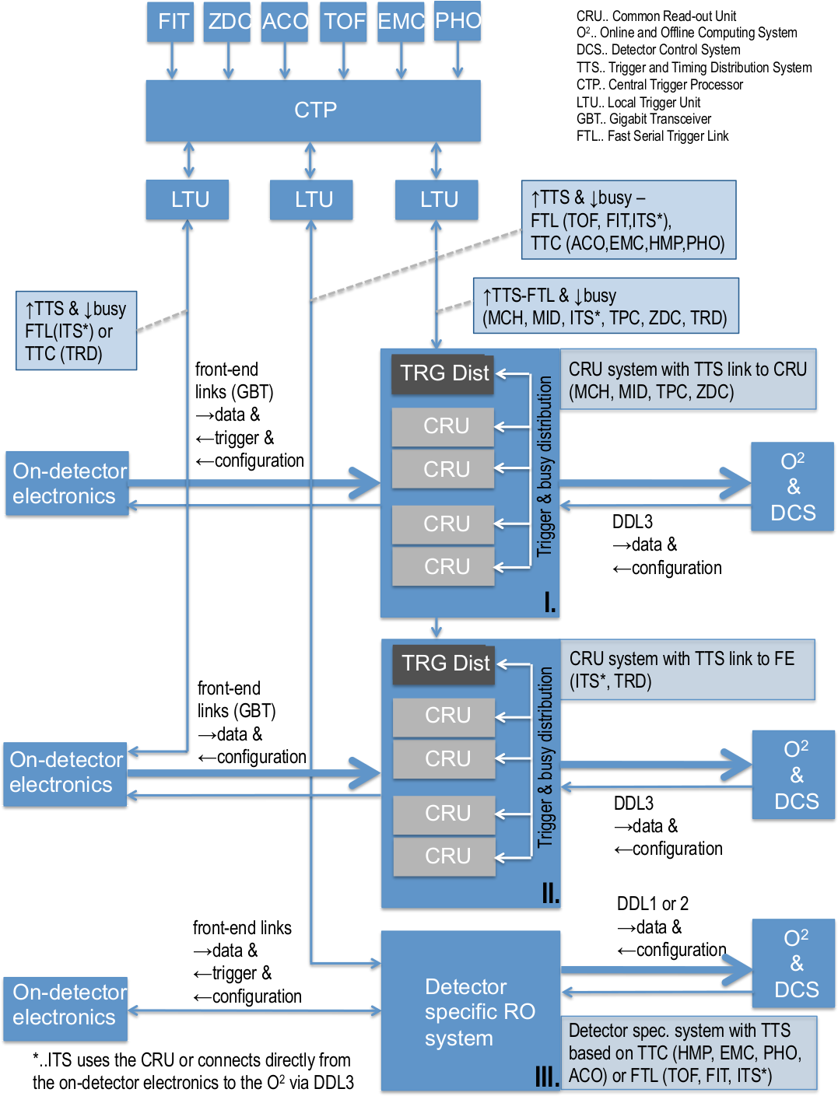
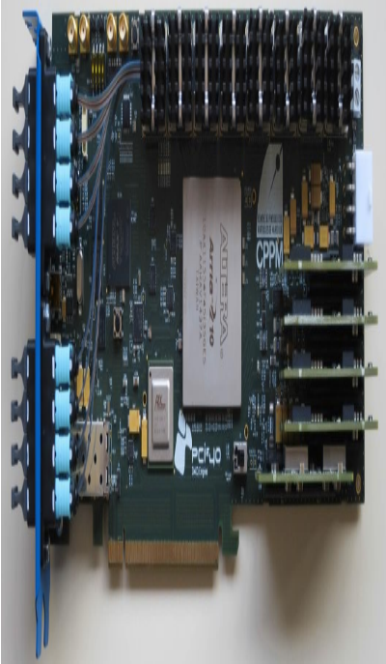
ALICE readout system
Common Readout Unit (CRU)
common design for at least “major” and “new” detectors
Detector Control System
trigger and timing distribution
data readout and processing with O(10) faster than CPUs
sorting, online processing
clustering (large FPGA), tracking (commercial GPU)
deploy ~350 for TPC (~6M CHF project)

Slide 10
Conclusive table of performance of upgraded ALICE
central barrel case
 | Run1+2 | Run3 | typical signals, physics
minimum bias event & untriggerable rare event | ~ 10⁹ events (recorded) ~ 0.1 nb^{—1} | x100 statistics = 10¹¹ (recorded) ~10 nb^{—1} | any kind of single particle analysis e⁺e— low invariant mass such as anti-nuclei (/⁴He) (already visible) low-pT multi-particle decay open heavy flavor baryons as tools Λc, Ωc hyper-nuclei such as ³_{Λ}H dibaryons (muti-)hyper nuclei
triggerable rare event | ~10¹⁰ events (inspected) ~1 nb^{—1} | x10 statistics = 10¹¹ (recorded) ~10 nb^{—1} | high p_{T} jet related observables high p_{T} gamma, electron such as ϒ and maybe top-quark related?

Slide 11
Roadmap
 | 2018 |  | 2019 |  | 2020 |  | 2021 |  | 2022 |  | 2023
LHC
Run2
Long Shutdown 2
Run 3
pp
last low lumi. H.I.
pp
1st H.I. @ 50 kHz 10⁶ sec
detector
GEM TPC construction
ALICE 1 nb⁻¹ rare trigger complete
readout system (CRU-firmware)
ALICE x100 event rate of Run2 aiming 10 nb⁻¹ m.b. on tape in 3 years
integration and commissioning
data taking
physics case considerations
commit for large procurements
physics
H.I. analysis
analysis preparations, simulations
pp reference analysis calibration
paper production
people @CERN
1-2
3-4
5-6
5-6
5-6
5-6
funding
larger fraction for hiring staff&postdoc, station at CERN
PHYSICS
OUTPUT in <5 years!
大山・郡司基盤B(~500万/y) for TPC CRU
志垣 新領域 クラスター階層 (~1500万/y?)
apply
新科研費 基盤S, 特推クラス応募予定(郡司・大山) (~4000万/y)

Slide 12
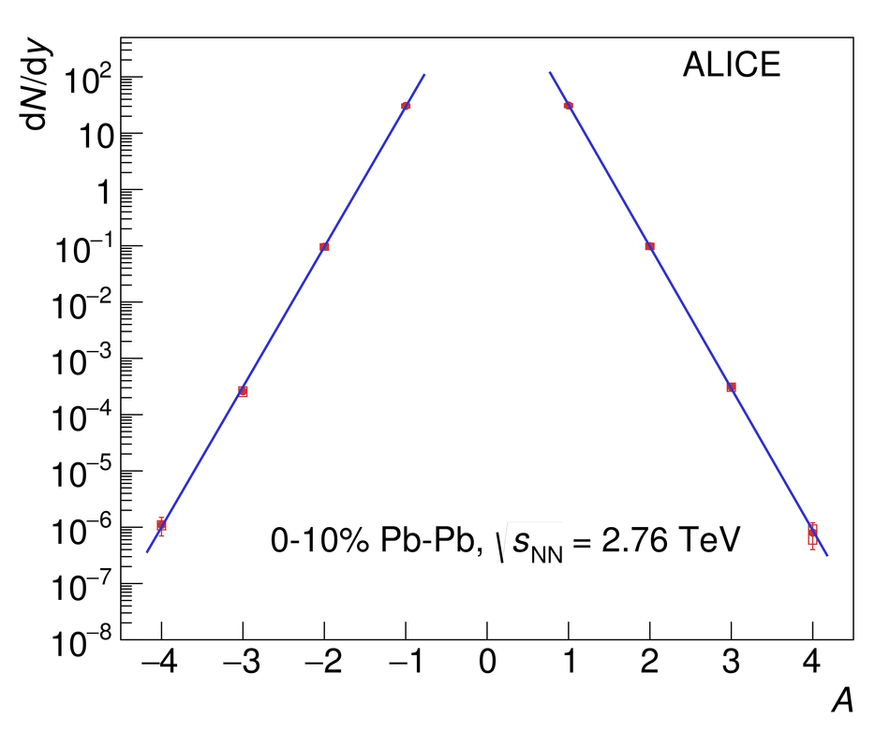
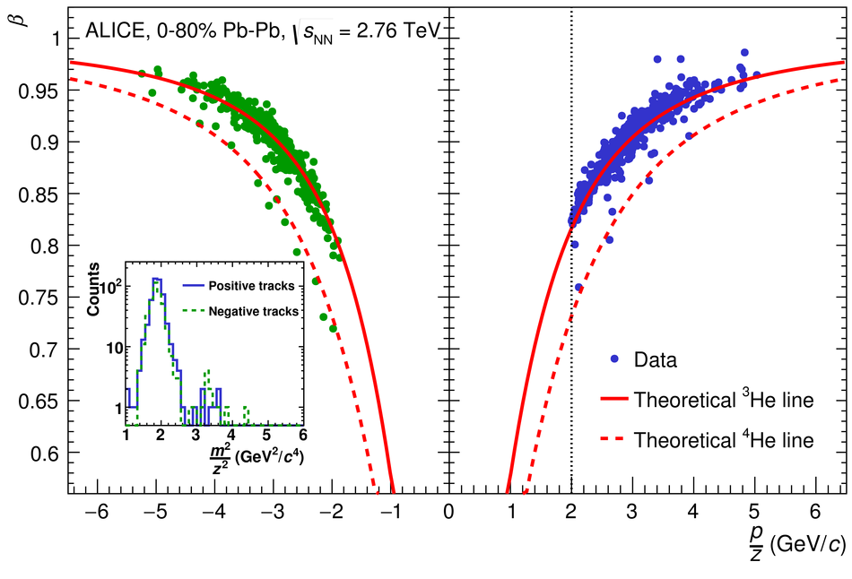
Light nuclei, anti-nuclei (performance check)
ALICE can identify measure ALL charged particles, nuclei, and charged decay daughters, as well as photons
Nuclei, anti-nuclei up to A=4 is measured in ALICE 2.76 TeV 40M Pb+Pb data in 2011
In Run3 data (100 billion), we expect x2000 statistics → ~20k ⁴He and 6M ³He
time of flight
rigidity
penalty factor ~ 300/nucleon
Nucl. Phys. A 971 (2018) 1-20 , arXiv:1710.07531

Slide 13
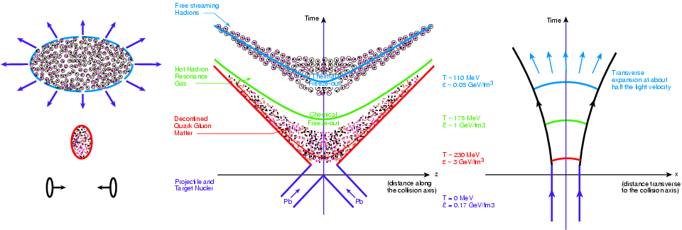
Space-time evolution in heavy ion collisions
residual interaction begins
chemical freeze-out: hadron yields determined
Drawings: http://na49info.web.cern.ch/na49info/Public/Press/findings.html

Slide 14
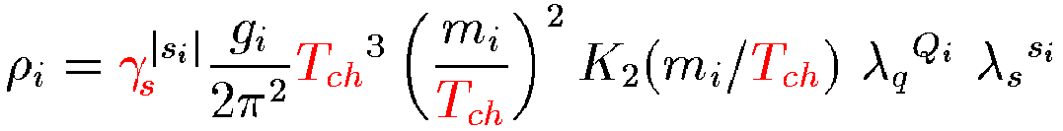

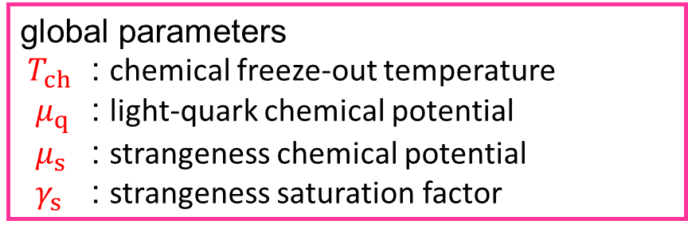
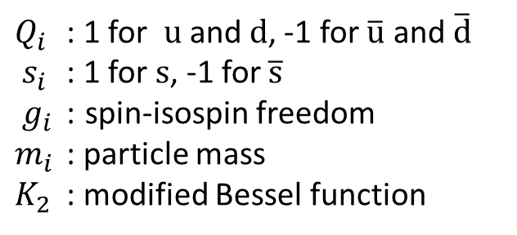
Chemical freeze-out hypothesis
Hadron yields are fixed at a certain time in the space-time evolution of heavy ion collisions (=end of inelastic scattering)
thermalized system complying hadrons with u, d, s quarks .. i.e. GCE: $ρ=\frac{g}{2π^{2}}\int_{0}^{∞}{\frac{p^{2}dp}{\exp\left[{\left(E−μ\right)}/{T_{ch}}\right]±1}}$
hadron yields are determined with the few global parameters
$Q_{i}$ : 1 for $u$ and $d$, -1 for $\overline{u}$ and $\overline{d}$
$s_{i}$ : 1 for $s$, -1 for $\overline{s}$
$g_{i}$ : spin-isospin freedom
$m_{i}$ : particle mass
$K_{2}$ : modified Bessel function
global parameters
$T_{ch}$ : chemical freeze-out temperature
$μ_{q}$ : light-quark chemical potential
$μ_{s}$ : strangeness chemical potential
$γ_{s}$ : strangeness saturation factor
Hadron yields → determine temperature and chemical potential at chemical freeze-out

Slide 15
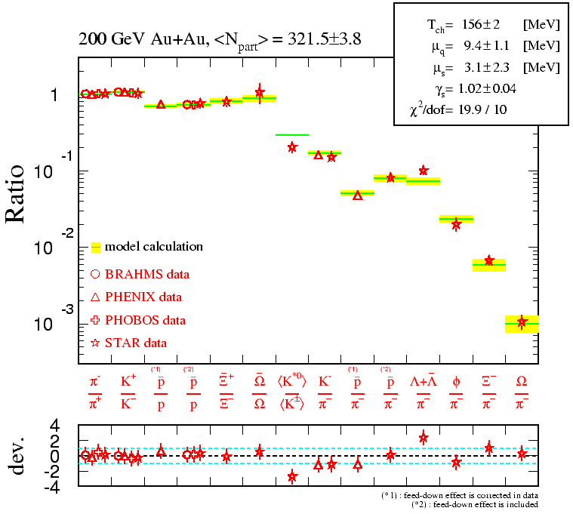
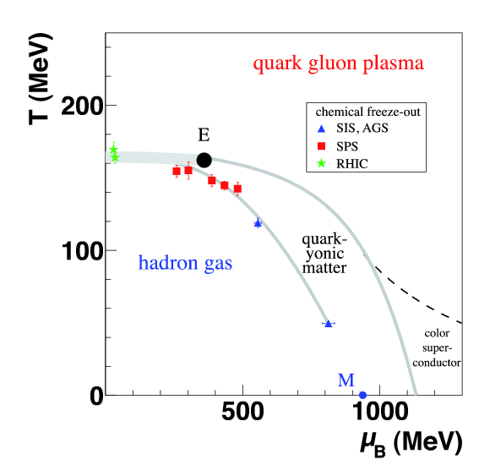
Hadron yields and chemical freeze-out
Hypothesis of chemical freeze-out works reasonably well to describe hadron yields for nuclear collisions in wide colliding energies.
Utilize this property to predict yield of specific particles
Chemical Freeze-out

Slide 16
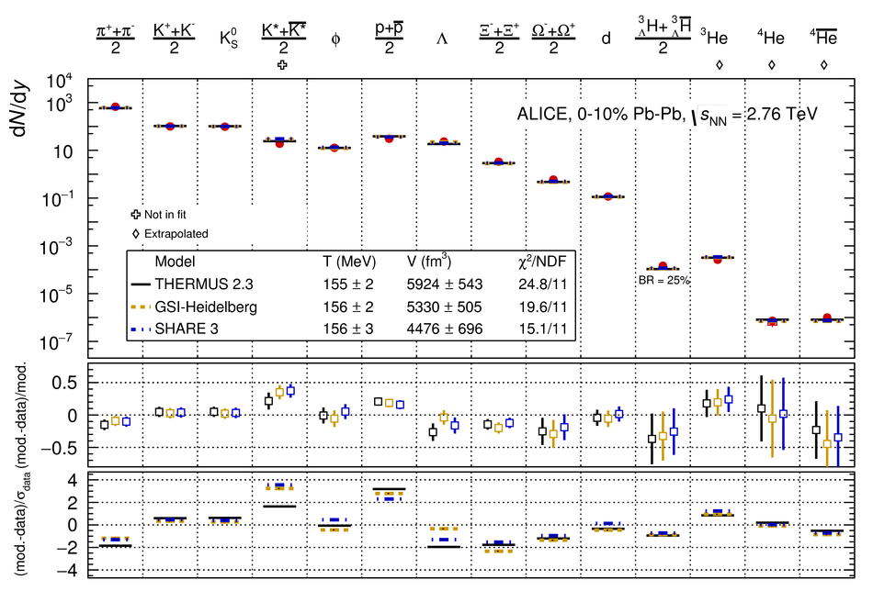
Thermal model at 156 MeV predicts yields well
Pb-Pb s_{NN}^{1/2} = 2.76 TeV, 10% central collisions
Yields from pion to ⁴He are fitted well with the CF models
NPA 971 (2018) 1–20
ALICE collaboration
Three CF models:
T_{CF} ~ 155-156 MeV
Yields are sensitive to
the CF temperature

Slide 17
Hadron yields vs. mass
Smooth trend with mass
Why the simple chemical freeze-out model works so well covering not only mesons but also to light nuclei?
T_{CF} ~ 155 MeV
T_{KF} ~ 100 MeV
BE(d) ~ 2.22 MeV
BE(³_{Λ}H) = 0.13 ± 0.05 MeV [NPA 754, 3c (2005)]
Naturevolume 561, pages321–330 (2018), A. Andronic, P. Braun-Munzinger, K.Redlich & J. Stachel

Slide 18

Expected yields for di-baryons
We can expect enough statistics even for ΩΩ in the LHC RUN3
In case when the yield deviate from the CF model expectation;
no bound state
production mechanism is different from those of normal nuclei
unique configuration
$$ΩΩ$$

Slide 19
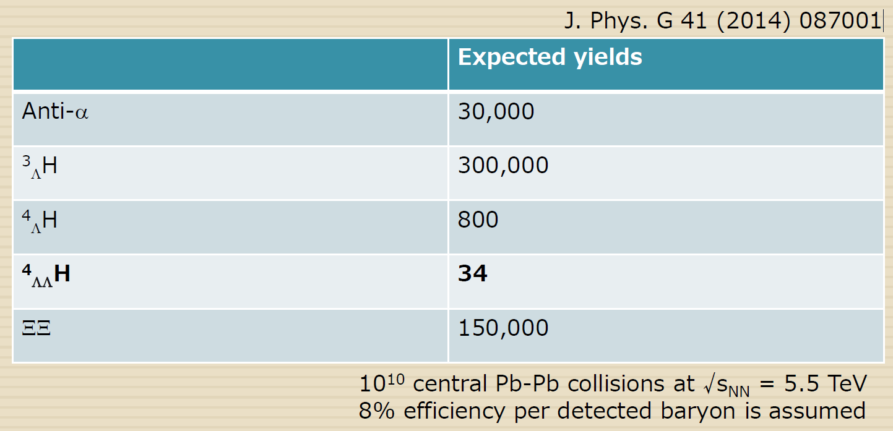

Expected yield
Run3 with x3000 statistics double-$Λ$ hyper nuclei is in target
slide by Y. Watanabe in ExHIC2016
numbers from Upgrade of the ALICE Experiment: Letter Of Intent

Slide 20
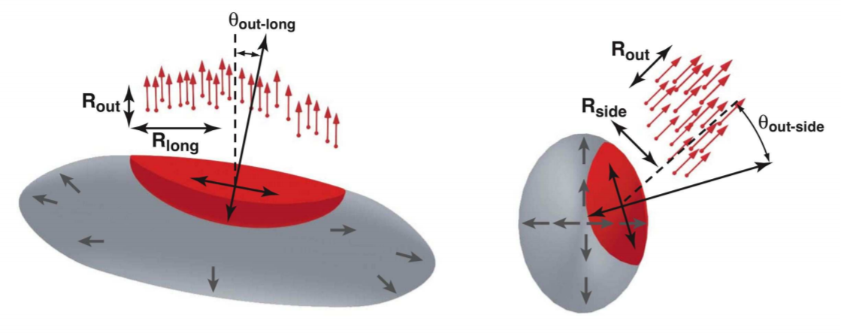
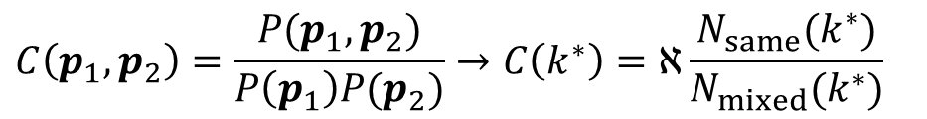
Methods for searching exotica in ALICE
Its collider with dN/dy ~ O(1000)
→ 1. statistical production by chemical freezeout time 2. or final state interactions after thermal freezeout
Direct measurement of invariant mass of two hadrons
finding bound state as a mass peak
unbound resonance state: useful for states with small decay width
Two particle correlation （femtoscopy）
Extension of binary scattering method
Measurement of final state interaction of two particles
HBT (Hanbury Brown and Twiss) effect
$$C\left(p_{1},p_{2}\right)=\frac{P(p_{1},p_{2})}{P\left(p_{1}\right)P(p_{2})}→C\left(k^{∗}\right)=ℵ\frac{N_{same}(k^{∗})}{N_{mixed}(k^{∗})}$$

Slide 21
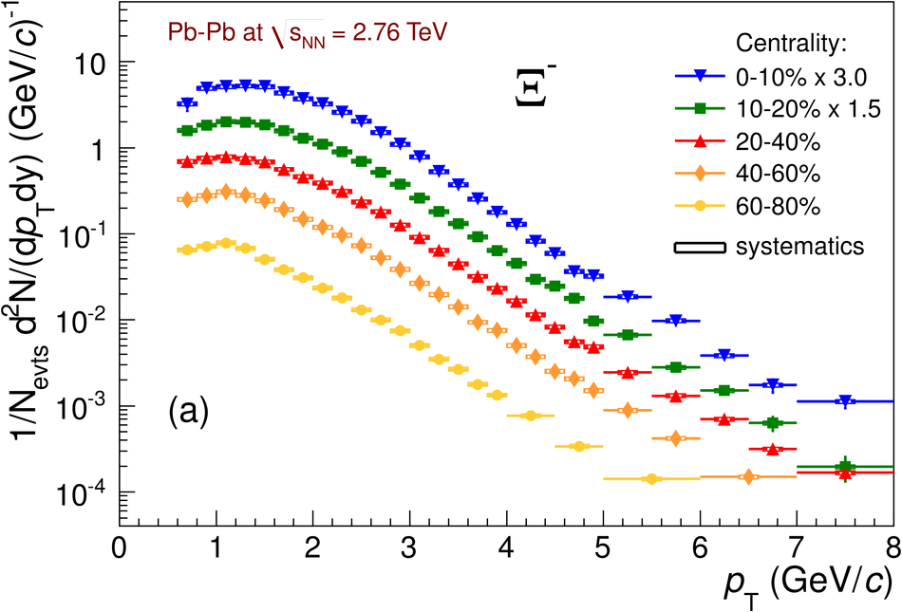
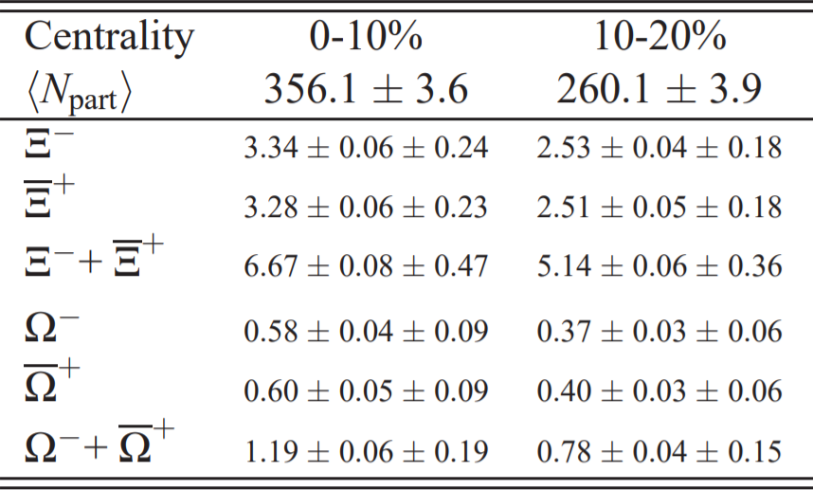
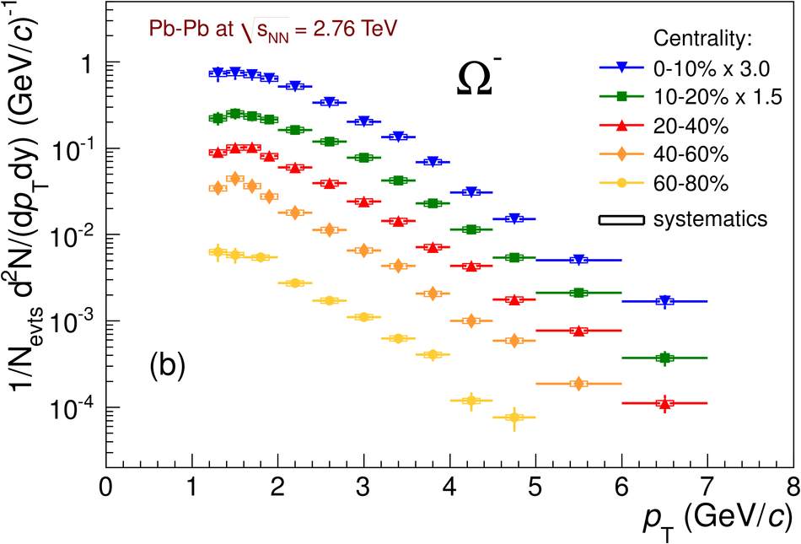
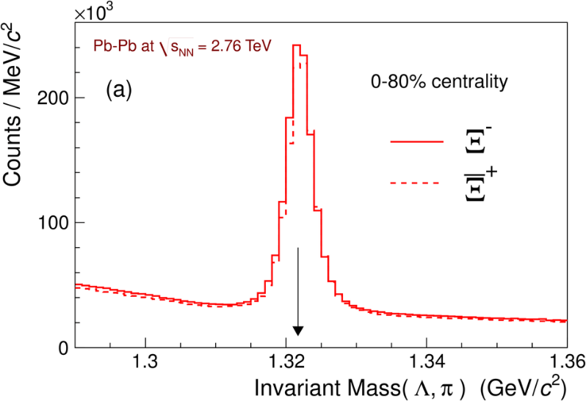
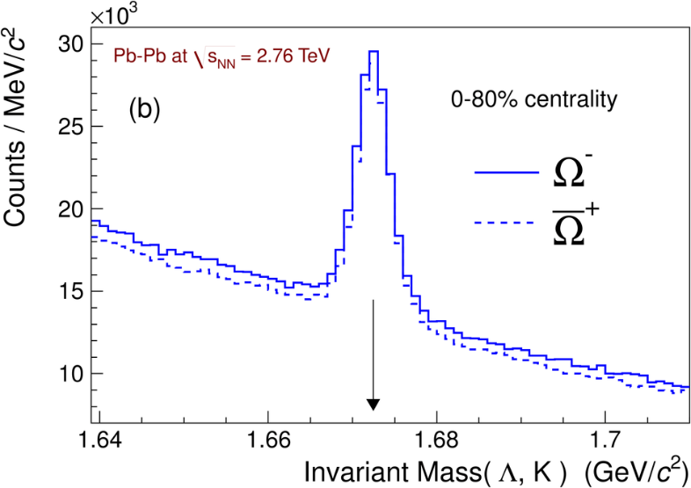

Multistrange baryons
Phys. Lett. B 728 (2014) 216-227
http://alice-publications.web.cern.ch/node/604
are $Ξ$ and $Ω$ yield in ALICE enough for $ΞΞ$ and $ΩΩ$ studies?
15M 2.76 TeV Pb+Pb MB data give enough of them through
$Ξ^{−}→Λ+π^{−}$ (99.9%)
$Ω^{−}→Λ+K^{−}$ (67.8%)
p_{T} spectra available
<10 $Ξ$ per event
<1 $Ω$ per event
Run3 statistics > x5000

Slide 22
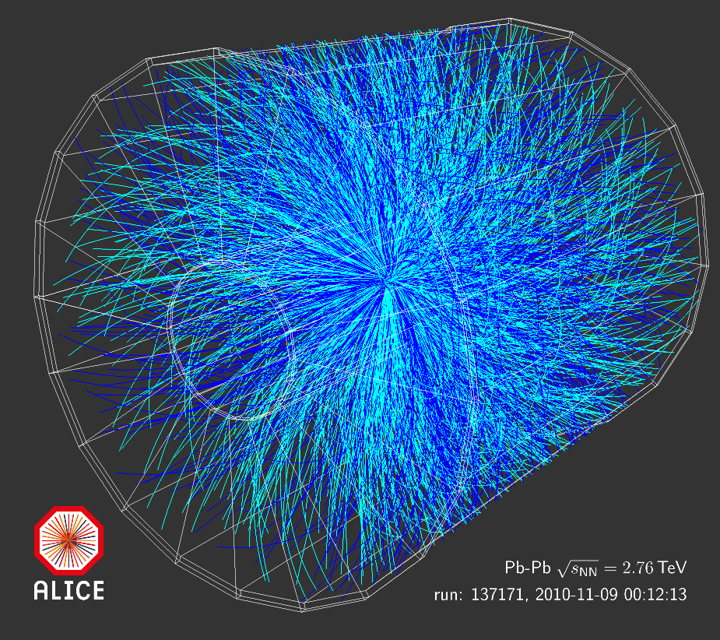
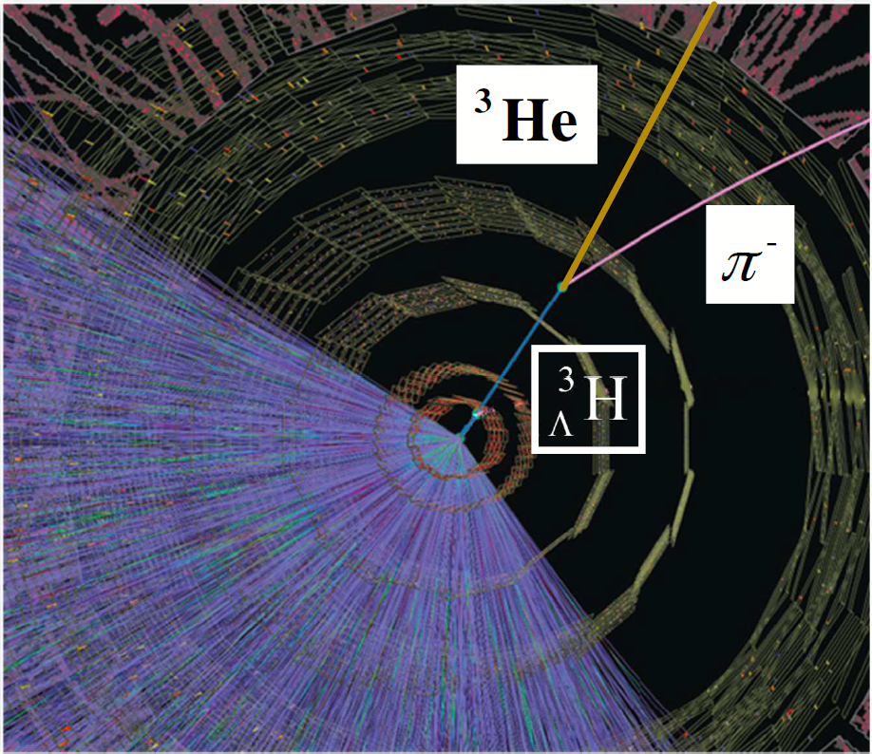
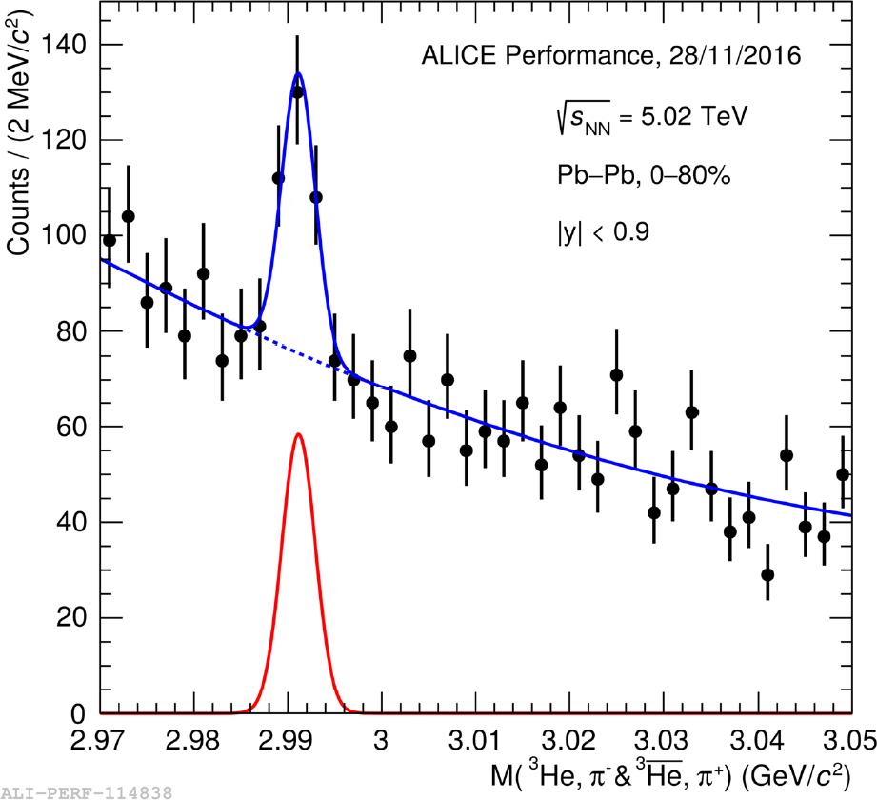
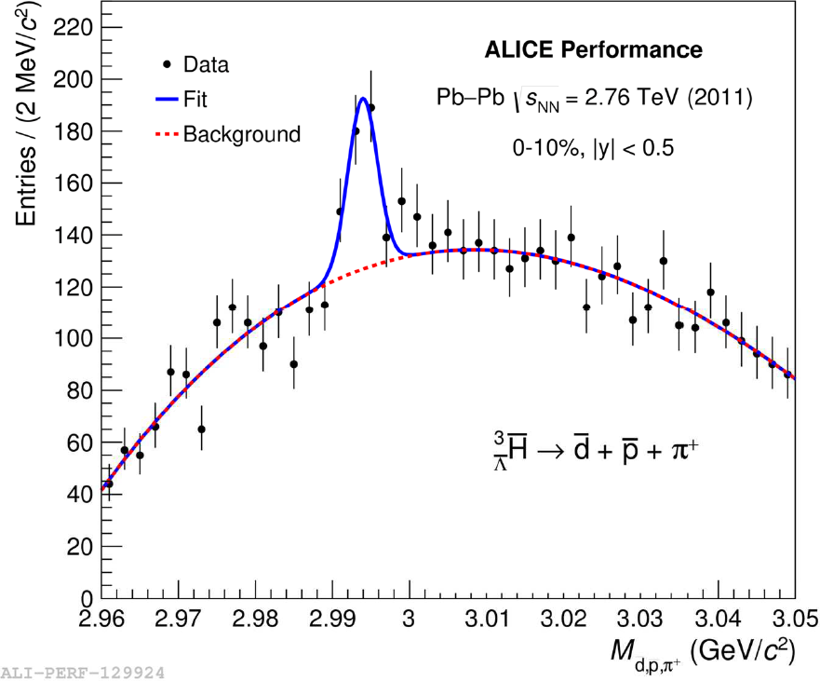

Hypertriton, anti-hypertriton
Use (anti-)nuclei and hyperon as tools:
${}_{Λ}^{3}H→{}_{ }^{3}{He}+π^{+}$ … 25% B.R. (plenty found)
${}_{Λ}^{3}H→{}_{ }^{3}H+π^{0}$
${}_{Λ}^{3}H→d+p+π^{−}$
${}_{Λ}^{3}H→d+n+π^{0}$
+ all anti-particle sets
B. Dönigus, Nuclear Physics A 904–905 (2013) 547c–550c
Phys. Lett. B 754 (2016) 360-372

Slide 23
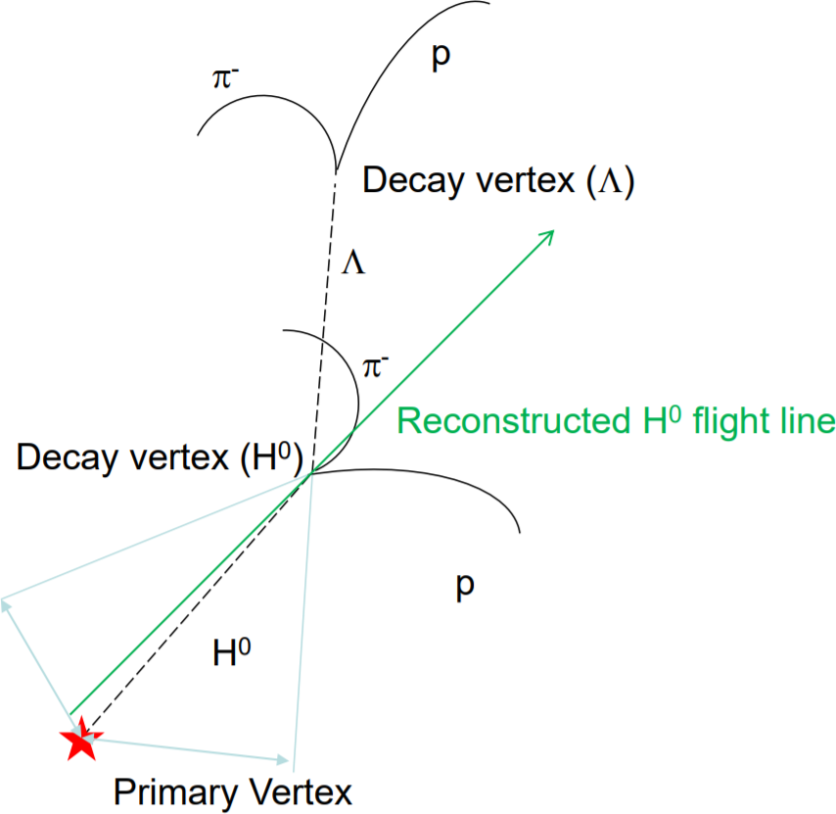
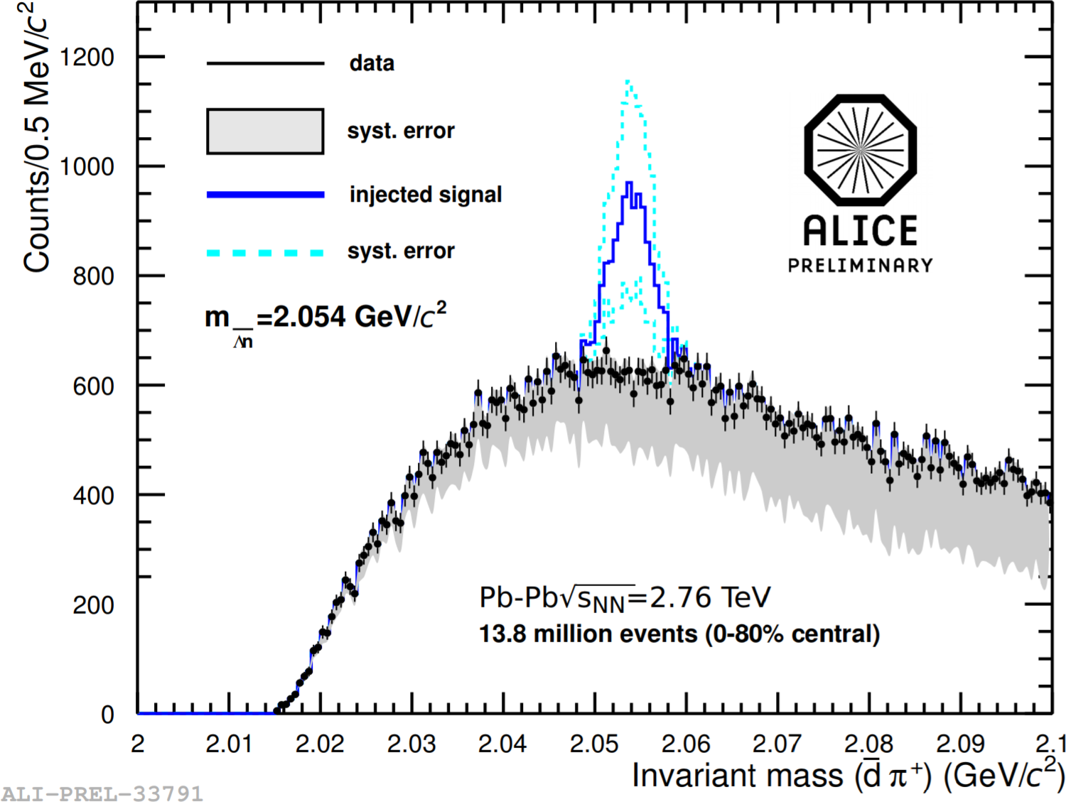
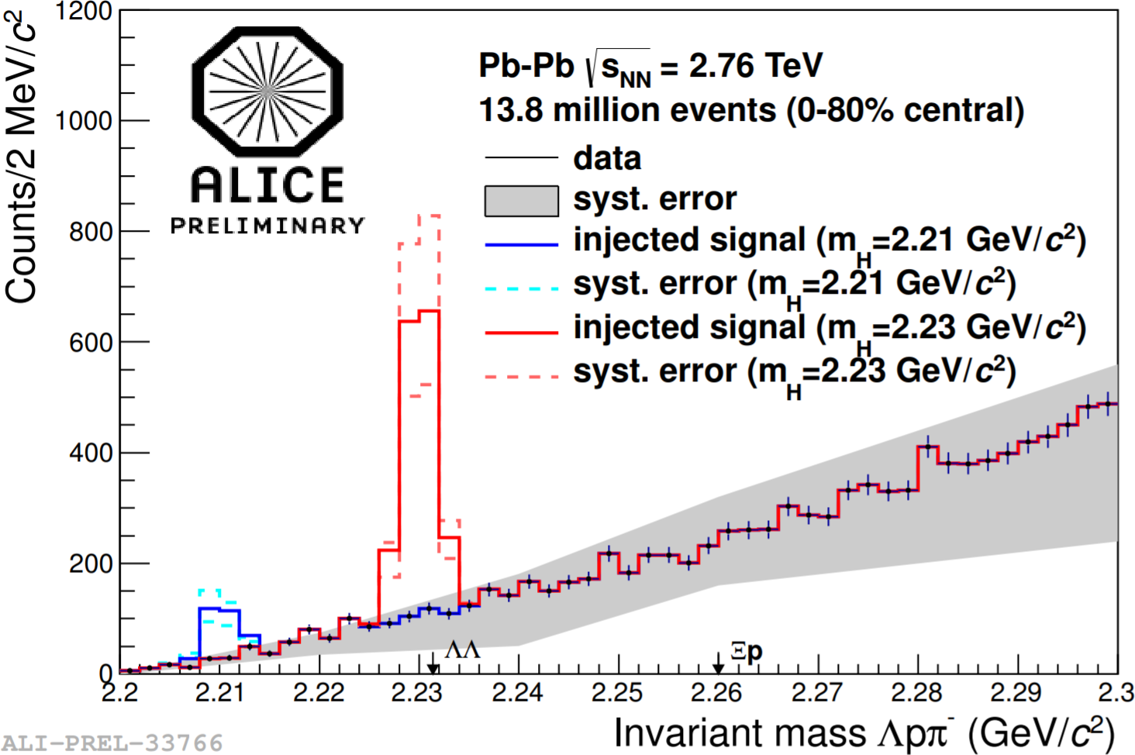

Dibaryon: direct search
B. Dönigus, Nuclear Physics A 904–905 (2013) 547c–550c
ALICE Coll.: EPJ Web of Conferences 97,00013 (2015)
$Λn→d+π^{−}$ mass spectrum … negative
$ΛΛ→Λ+p+π^{−}$ mass spectrum … negative
analysis based on 2-3 % of already obtained data
need confirmation in Run3 data with x3000 statistics

Slide 24
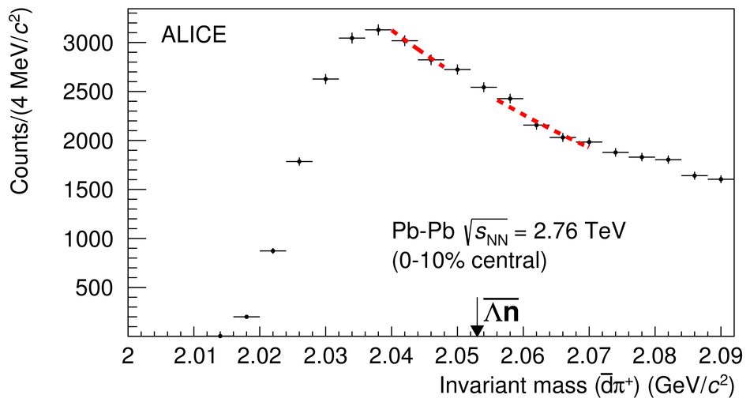
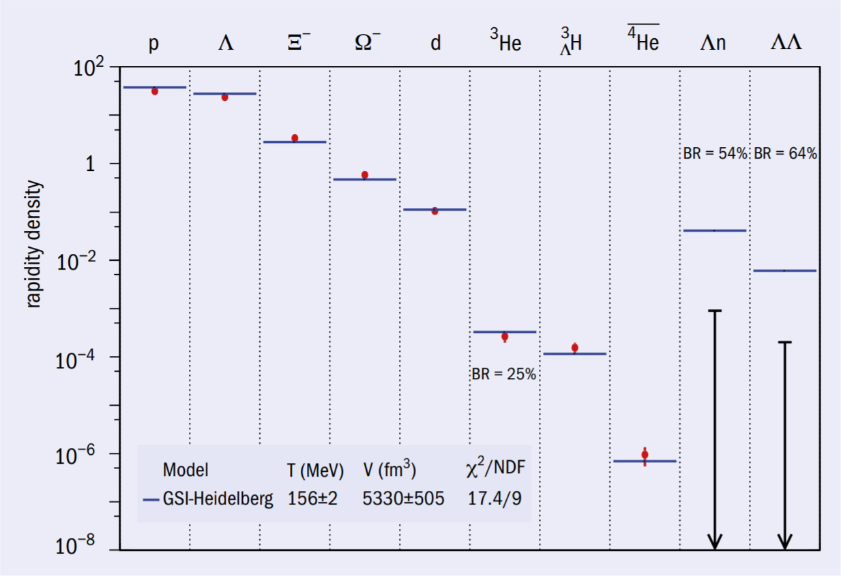
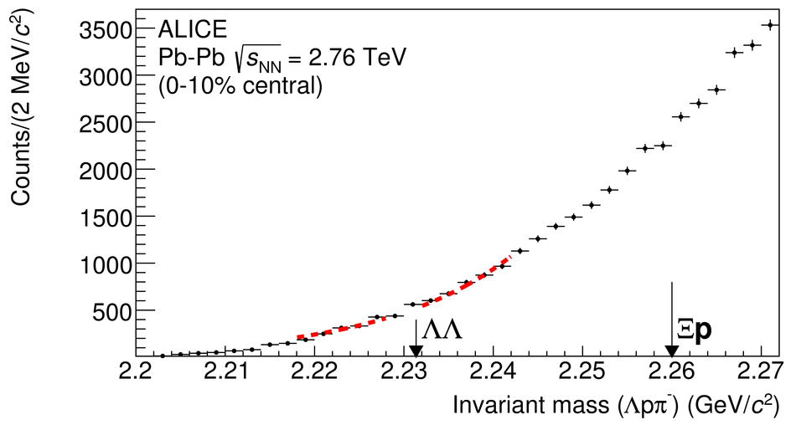
Dibaryon: direct search
20M PbPb central data
Phys. Lett. B 752 (2016) 267-277
http://alice-publications.web.cern.ch/node/1650
CERN Courier Sep. 2015

Slide 25
ΛΛ Correlation in pp & pPb (femtoscopy)

Slide 26
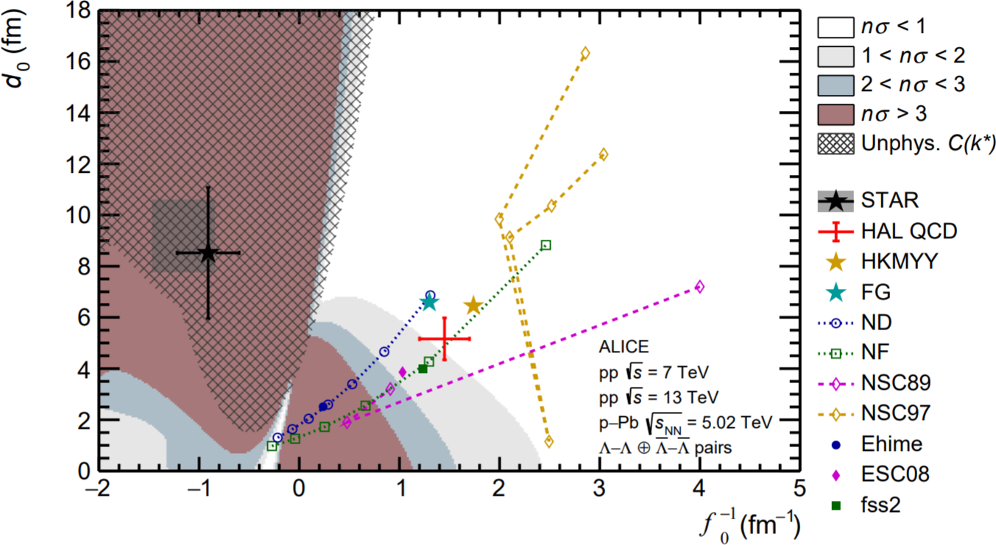

ΛΛ Correlation in pp & pPb (femtoscopy) cont.
The scattering parameters, d₀ (effective range) and f₀⁻¹,(inverse scattering length), have large ambiguity, because the correlation function is very flat
Possible bound state in the region at slightly negative f₀⁻¹ and d₀ < 4
Paper accepted: arXiv:1905.07209

Slide 27
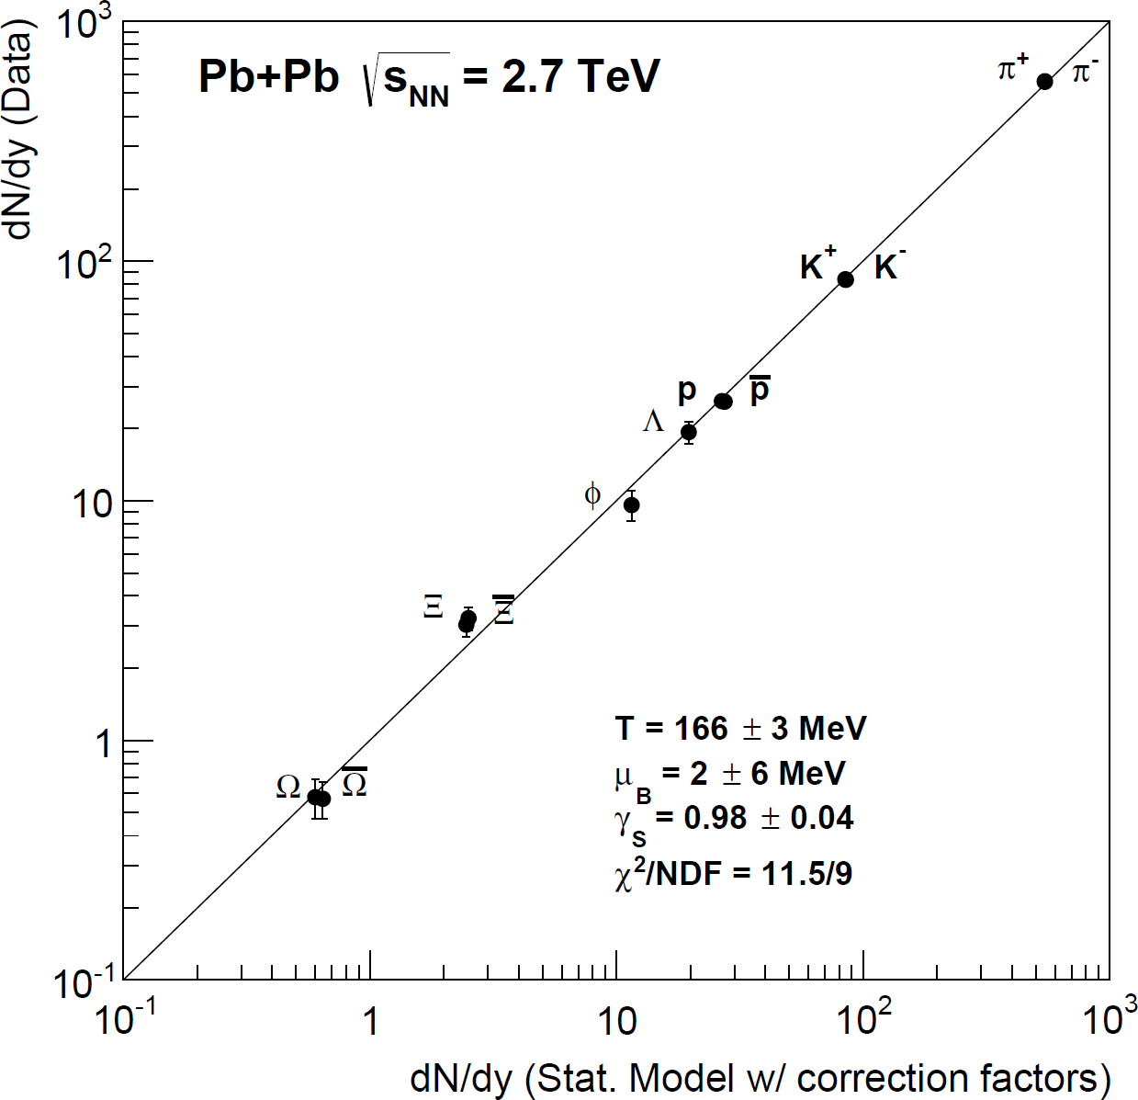


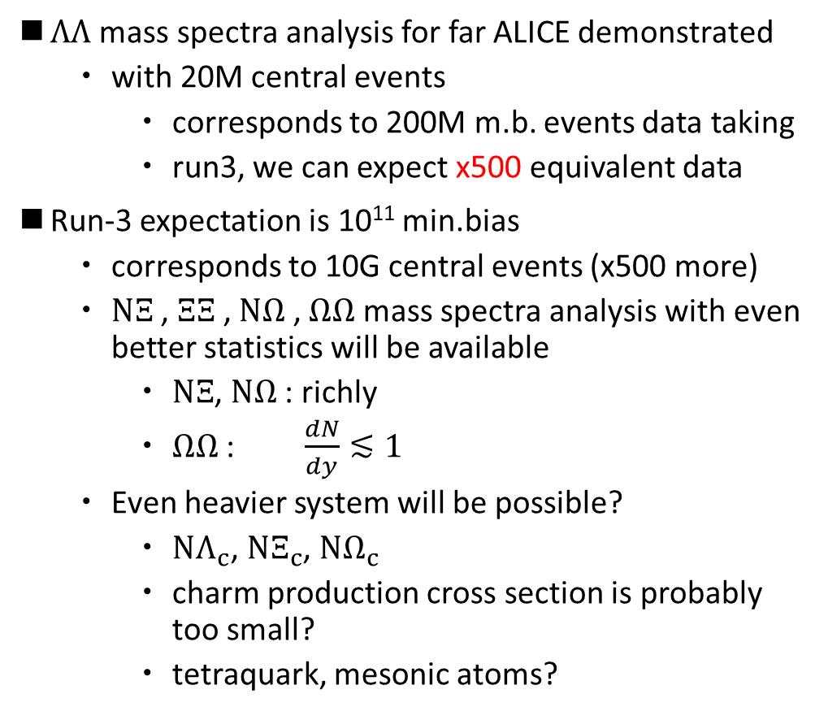







$Ξ$, $Ω$ dibaryon and further exotica
F.Becattini et al, PRL 111, 082302
https://arxiv.org/pdf/1212.2431.pdf
$ΛΛ$ mass spectra analysis for far ALICE demonstrated
with 20M central events
corresponds to 200M m.b. events data taking
run3, we can expect x500 equivalent data
Run-3 expectation is 10¹¹ min.bias
corresponds to 10G central events (x500 more)
$NΞ$ , $ΞΞ$ , $NΩ$ , $ΩΩ$ mass spectra analysis with even better statistics will be available
$NΞ$, $NΩ$ : richly
$ΩΩ$ : $\frac{dN}{dy}≲1$
Even heavier system will be possible?
$NΛ_{c}$, $NΞ_{c}$, $NΩ_{c}$
charm production cross section is probably too small?
tetraquark, mesonic atoms?
$$×\frac{1}{40}$$
$$×\frac{1}{8}$$
1321 MeV/c²
1672 MeV/c²
$Λ_{c}$ 2286 MeV/c²
$Ξ_{c}$ 2470 MeV/c²
$Ω_{c}$ 2698 MeV/c²
$$×\frac{1}{500}$$
$Ξ_{cc}$ 3518 MeV/c²
$Ω_{cc}$ ~3600 MeV/c² ?
$Z_{c}$ ~3900 MeV/c²

Slide 28

$pΞ$correlation in p-Pb
$pΞ$ correlation in p-Pb showed >>1 at low k* in p+Pb collision : hint for attractive nuclear force?
in $pΞ^{−}$ correlation, coulomb “only” is excluded at >4σ
precise study with comparison among pp, pA, and AA, combining with phenomenology will be needed, and possible in Run3 (> x100 statistics)

Slide 29
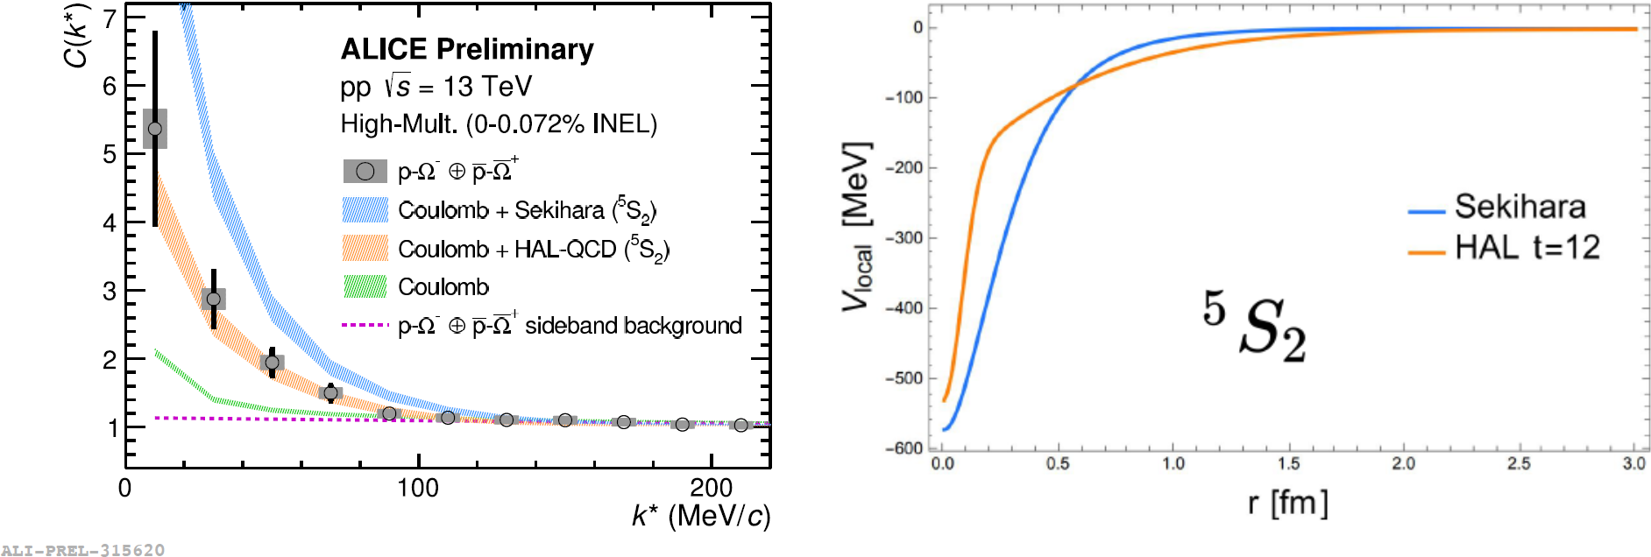
$pΩ$ correlation
new ALICE measurement (preliminary) shows that data agrees with Coulomb+strong attractive interaction (hint for bound state?)
see detail in L.Fbbietti, SQM2019

Slide 30

charmed baryon?
arXiv: 1809.10922
$Λ_{c}→p+K^{−}+π^{+}$
not well measured/understood even in pp collisions
yield increases with temperature (x2 high in PbPb than pp,p+Pb)
seem equal or more to D⁰ yield (76 mb in p-Pb)
3x10⁻² per pA event → dN/dy = O(10⁻²)
in Pb+Pb, it could be O(1) ~ O(10⁻¹) (dN/dy=1.4 CERN-LHCC-201)
signal extraction not easy due to large background
coalescence
models

Slide 31
Summary and Outlook
Summary
Chemical freeze-out model reproduces rather well the hadron yields from pions to light nuclei
Present status of di-baryon and (multi-)strange baryon searches was shown
Outlook
Strange di-baryons: Studies with high statistics data at LHC RUN3 is expected; ΩΩ, ΞΩ, ΞΞ, ...
ALICE may extend searches also for heavy flavor (di-)baryons
Total number of strangeness | Combination | Current status | LHC RUN3
1 | N+Λ（N+Σ） | △ Au+Au 200GeV (STAR) p+Nb 3.2GeV (HADES) p+p 7TeV, 13TeV (ALICE) | ○
2 | Λ+Λ（Λ+Σ, Σ+Σ） | △ Au+Au 200GeV (STAR) p+p 7TeV, 13TeV (ALICE) | ○
2 | N+Ξ | △ p+p 13TeV (ALICE) △ p+Pb 5.02TeV (ALICE) | ○
3 | N+Ω | △ Au+Au 200GeV (STAR) | ○
3 | Λ+Ξ（Σ+Ξ） | × | ○
4 | Ξ+Ξ | × | ○
5 | Ξ+Ω | × | ○
6 | Ω+Ω | × | ○

